Slide 1
Credit Card Customer Churn Prediction
BIT 5534 Group 5
Ashley Thomas, Scott Hoge, and Alex Chin
Spring 2024

Slide 2
Objective
Our goal is to identify patterns in our data set that will allow us to predict which customers are at risk for discontinuing services (churn) at a credit card company. The hope is to understand the factors that contribute to customer dissatisfaction or disengagement prior so that we can intervene prior to losing that customer.

Slide 3
Data
The dataset was sourced from Kaggle
Credit Card customers (kaggle.com)
10,127 observations
19 independent variables
Nominal, ordinal, discrete, and continuous data types
Dependent variable Attrition_Flag is a binary categorical variable with values “Existing Customer” and “Attrited Customer”
Customer demographics and credit card habits including age, gender, dependents, income, credit limit, etc.

Slide 4
Data Preprocessing
Data was analyzed utilizing JMP
Histograms, box and whisker plots, and scatter plots to visualize the data for easier identification of any significant patterns (i.e. outliers, skewness, correlation, etc.)
Some of our variables are highly skewed and that could have a significant impact on our regression model’s predictive ability
Attrition_Flag, our target response variable, is a binary field with 1627 attritted customers (16.1%) and 8500 existing or retained customers (83.9%)
Added a Validation column to support separate training and validation subsets
7595 observations in the training set and 2532 observations in the validation set

Slide 5
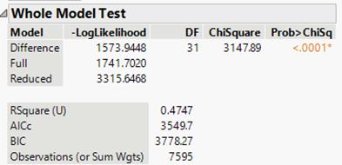
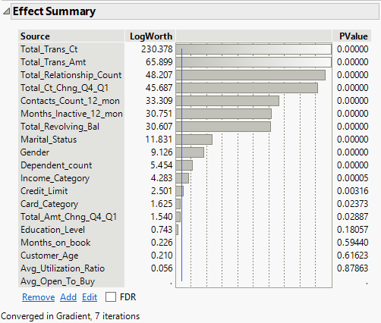
Initial Logistic Regression Model
Our initial investigation model was a nominal logistic regression model and the fit details for that model resulted in an R² of 0.4747 on the training set and 0.4604 on the validation set. The misclassification rate was 0.0927 and 0.1011 for the two sets, respectively.
Measures | Logistic Regression
R² | 0.4747
RASE | 0.2606
AICc | 3549.7
BIC | 3778.27
Misclassification Rate | 0.0927
AUC | N/A
The logistic regression model was run to get a baseline on our data, to compare these results to the other data mining techniques. The overall results of this model were fairly underwhelming in looking at the key model metrics.

Slide 6
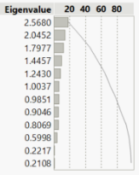
Principal Component Analysis
The original data set included 19 independent variables, but since the principal component analysis (PCA) cannot be used with categorical variables, 6 of the independent variables were not included in this analysis.
For the remaining 13 variables the PCA was performed with eigenvalues ranging from 2.5680 for the first principal component to 0.1677 for the last (thirteenth) principal component.
  The eigenvalues for principal components 2 through 7 range from 2.0452 to 0.9851
  The first 7 principal components explain approximately 80% of the variation
Our final conclusion was to build our model using 7 principal components.

Slide 7
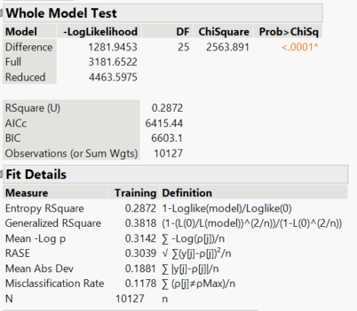
Principal Component Analysis – Logistic Regression
We performed a logistic regression analysis that incorporated our 7 principal components AND our remaining categorical independent variables
Measures | PCA - Logistic Regression
R² | 0.2872
RASE | 0.3039
AICc | 6415.44
BIC | 6603.1
Misclassification Rate | 0.1178
AUC | N/A
It does not appear that the PCA analysis would be a good fit for our data compared to the initial logistic regression model. This model performed significantly worse with an R2 of 0.2872, RASE of 0.3039, and a misclassification rate of 0.1178.

Slide 8
Neural Network
Multiple neural network models were constructed, starting with the default model with 3 neurons in a single hidden layer. This model provided a good result with an R² score of 0.6922, one of the better results seen to date. The RASE was 0.2362 and the model was able to accurately predict 96.6% of the existing customers and 69.7% of the attrited customers in the validation set, a misclassification rate of 0.0794.
Additional models were created with 5 neurons in one hidden layer, 5 neurons in hidden layer 1 and 3 neurons in layer two, 5 neurons in two hidden layers, and 8 neurons in two hidden layers.

Slide 9
Neural Network
Results Comparison
Model # | Layer 1 Nodes | Layer 2 Nodes | R² | RASE | MAD | Misclassification Rate
1 | 3 | - | 0.6922 | 0.2362 | 0.1070 | 0.0794
2 | 5 | - | 0.7761 | 0.1992 | 0.0763 | 0.0541
3 | 5 | 3 | 0.8296 | 0.1841 | 0.0639 | 0.0454
4 | 5 | 5 | 0.8324 | 0.1791 | 0.0613 | 0.0430
5 | 8 | 8 | 0.7802 | 0.1922 | 0.0638 | 0.0438
Note: R², RASE, MAD and Misclassification are for the validation dataset
Of the neural network models, model #4 with 5 hidden neurons on each of the two hidden layers provided the best results, with a R² score of 0.8324.
Model 5 with 8 neurons on the two hidden layers showed a reduced R², potentially signaling overfitting, so further exploration was not performed.

Slide 10
Model Comparison
Measures | Logistic Regression | PCA - Logistic Regression | Neural Network (3 neuron) | Neural Network (5+5 neuron)
R² | 0.4747 | 0.2872 | 0.6922 | 0.8324
RASE | 0.2606 | 0.3039 | 0.2362 | 0.1791
AICc | 3549.7 | 6415.44 | N/A | N/A
BIC | 3778.27 | 6603.1 | N/A | N/A
Misclassification Rate | 0.0927 | 0.1178 | 0.0794 | 0.0430
AUC | N/A | N/A | 0.9634 | 0.9905
Overall, we felt that the neural 5+5 model was the best performing model for our dataset.
The neural 5+5 model training set was able to accurately predict 87% of the customers that eventually left the company and the accuracy of this model only declined slightly to 84% when run on the validation set.

Slide 11
Conclusions
Logistic regression model was underwhelming in looking at the R² (0.4747) and RASE (0.2606), and misclassification rate (0.0927).
Principal component analysis performed significantly worse with an R² of 0.2872, RASE of 0.3039, and a misclassification rate of 0.1178.
Experimented with a several neural network models and noted that the highest performing one had 2 layers with 5 nodes in each layer (5+5 Model). R² of 0.8324, RASE of 0.1791, and a misclassification rate of 0.0430.
Neural 5+5 model was the best performing model for our dataset
If we were able to accurately identify 84% of customers prior to leaving and we were able to retain 50% of those customers. This would result in a reduction of our current attrition rate of 16.1% to an attrition rate of 9.3% by retaining those additional 683 customers from our dataset.
If we assume that the company gets 3% of all credit card transactions and collects 24.37% (current national average) interest on revolving credit card balances, then this would result in additional revenues of $90K and $194K on annual spend and revolving balance per customer, respectively.

