Slide 1

Employee Turnover: Semester Project
Garrett Moseley, Josh Secrist, Mimi Tran

Slide 2
Business Problem
TECHCO is a technology company focused on developing strategies to reduce employee turnover within the company
HR collected data from 1,191 employees over the course of 40 months
We aim to answer the following questions:
  What combination of attributes result in high employee turnover rates?
  What additional factors are needed to predict employee turnover?

Slide 3
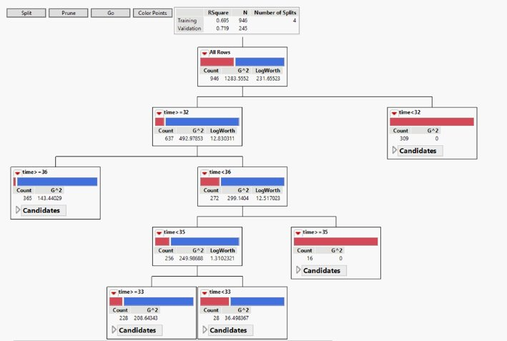
Decision Tree Model Discussion
Notes:
The decision tree model is the first one we'll talk about, since it was our primary model as well as our best performing model. 8 independent variables were used, turnover was the target variable, and 20% of the dataset was randomly chosen to be the validation portion for the model. The automatic splitting split the dataset four times, as seen here. Age was the decisive splitting device used, and some interesting notes here are that it seems like the ages 32 and 36, it seems like that a majority of these leaving the company happen below the age of 32, and all those that make it to 36, tend to stay with the company. This is likely due to younger people being more likely to bounce around jobs after college in the hopes of getting a competitive salary, and those in their mid-late 30s need to start thinking about retirement.

Slide 4
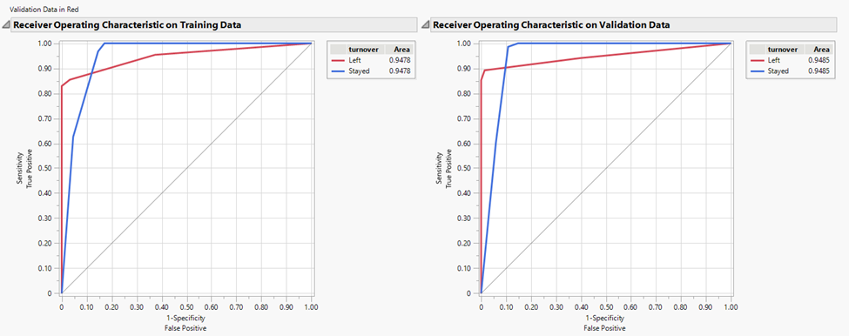
Decision Tree Model Figures
Stat | Training | Validation
Entropy RSq | .6954 | .7190
Generalized RSq | .8225 | .8391
RASE | .2431 | .2267
True Positive | .829 | .853
False Positive | .171 | .147
True Negative | 1.0 | 1.0
False Negative | 0.0 | 0.0
Notes:
Here we see the ROC curve for the data and the "hard-stats" for this model. You can see that the ROC curve comes pretty close to that top left corner where the "perfect" model would go. Some stats of note are the generalized Rsq values and the True Negative values, the generalized Rsq is the highest across the three models, and we had a 100% true negative prediction rate.

Slide 5
Neural Network Model Discussion
Run | K-Fold Training | K-Fold Validation | Holdback Training | Holdback Validation
RSquare
Untransformed | 0.8091 | 0.8142 | 0.8064 | 0.7770
Transformed | 0.8139 | 0.8248 | 0.8036 | 0.7770
RASE
Untransformed | 0.2539 | 0.2498 | 0.2567 | 0.2659
Transformed | 0.2498 | 0.2483 | 0.2556 | 0.2689

Slide 6
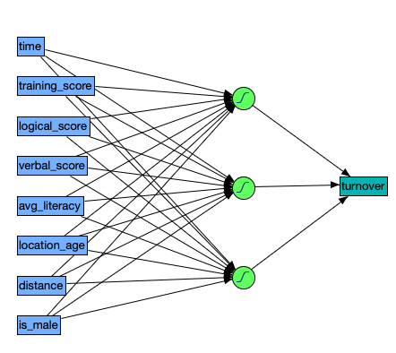
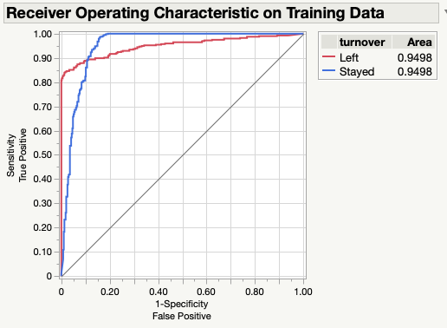
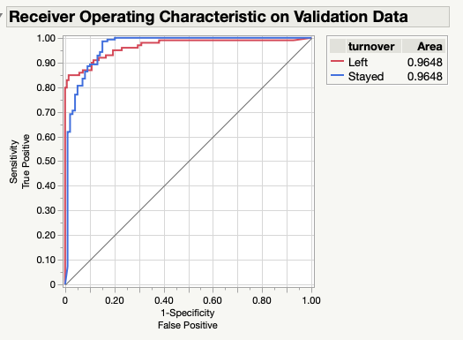
Neural Network Model Figures
ROC Curves for Transformed K-Fold Validation Method
Neural Network Diagram of TECHCO Dataset

Slide 7
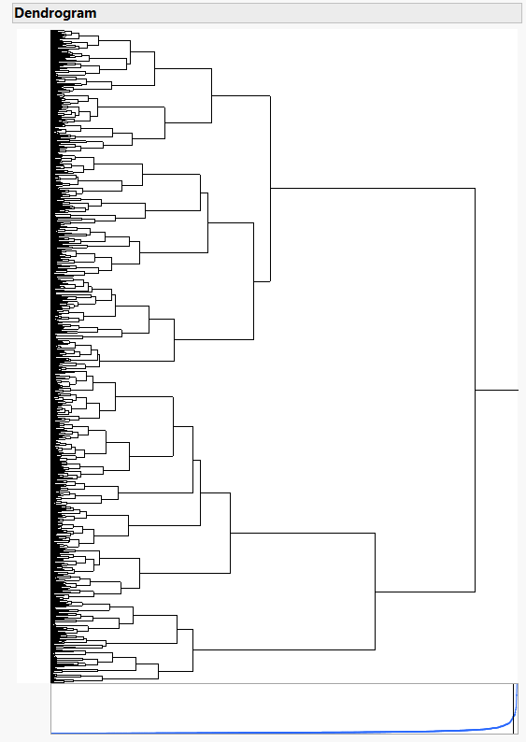
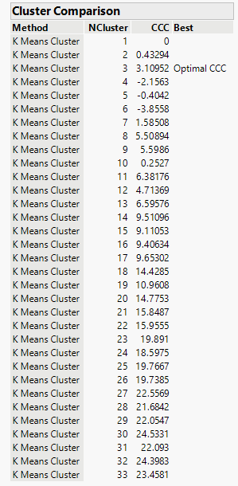
k-Means Clustering – Preparation

Slide 8
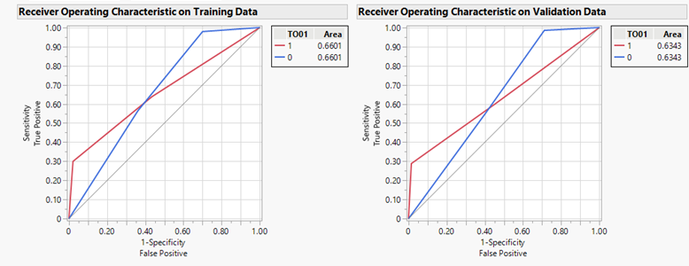
k-Means Clustering – Regression Results
Metric | Training | Validation
Generalized R-Square | 0.2153 | 0.2082
RASE | 0.4498 | 0.4568
Misclass. Rate | 0.2991 | 0.3193
Correctly Classified | 668 | 162
False Positives | 12 | 2
False Negatives | 273 | 74
Records | 953 | 238

Slide 9
Model Comparisons
Model | Training Data |  |  | Validation Data
 | Gen. R-Square | RASE | Misclass. Rate | Gen. R-Square | RASE | Misclass. Rate
Decision Tree | 0.8225 | 0.2431 | 0.0708 | 0.8391 | 0.2267 | 0.0612
Neural Network | 0.8139 | 0.2498 | 0.0756 | 0.8248 | 0.2483 | 0.0798
k-Means Clustering (k = 3) | 0.2153 | 0.4498 | 0.2991 | 0.2082 | 0.4568 | 0.3193

Slide 10
Selected Model
Out of the three models we chose to focus on, one model was preferred across three primary metrics:
  The Decision Tree model had the highest generalized R-Square, lowest RASE, and lowest misclassification rate across both the training and validation data.
Ranking the models... (1) Decision Tree, (2) Neural Network, and (3) k-Means Clustering
The Decision Tree model performed the best out of the three models. Given its performance and simplicity, we recommend that TECHCO use this model for analyzing and predicting employee attrition.

Slide 11
Findings and Take-aways
What we recommend
  Salary and PTO
    Adjust company values
    Meet needs/wants of younger employees
  More data the merrier
    Marital status
    Children
    Insurance opt-in
    PTO days taken
    Manager
Notes:
At the end of the day, any recommendations that we make can only be improved in the future with more data collection. As far as the recommendations go, from our modeling we can see that it tends to be the younger ages that leave the company so making changes that will benefit and promote them to stay long term will be the best course of action. This can be that maybe the company values don't align with a Gen Z or Millennial point of view, it could be adjusting the salary to be more competitive with other companies hiring college grads, or maybe to adjust benefit packages to appeal to people aiming for more vacation and less medical coverage. As far as data is concerned, it would be useful to know if these employees are married, what their family size looks like, if they're taking the company insurance or not, who their manager is,and how much of their PTO do they use. These data points can help pin-point what in particular is making them leave such as problematic managers/supervisors and those looking to start families tend to stay or not.

