Slide 1


Applying CRISP-DM to Understand the
New York Metropolitan Area Real Estate Market
BIT 5534: Applied Business Intelligence and Analytics
May 2024
Group 2:
Tena Gebeyehu Guta
Mark Alan Beadle-Kindy
Mohammad Maged Rady

Slide 2
Business Understanding
Scenario: The management of Sunshine Real Estate provides stakeholders with insights on real-estate markets to better understand residential home sale valuations and pricing dynamics and is looking to expand operations into the New York city housing market.
Key Questions:
What are the primary determinants that affect housing prices in New York?
Which independent variables affect the housing prices in New York, and how?
What geographical patterns influence housing prices in New York?

Slide 3
Collected Data
The raw dataset was obtained from Kaggle.com and contains list prices for currently listed properties (as of January 2024).
This dataset was selected for its:
Large size (originally containing 4,081 instances)
Specific focus on the New York city metropolitan area
Variety of geographic features
Sufficient quantity of continuous data fields for linear regression and predictive modeling.
After data preparation, the final dataset contains 17 variables (6 continuous, 5 binary, 5 categorical, and 1 text field) and 2,886 rows.
The data dictionary (shown in Table 1) effectively categorizes the dataset by type, such as single-family homes, multi-family homes, townhouses, condominiums, and co-operatives through binary indicators.
Attribute Name | Data Type | Attribute Description
Single-family home | Binary | Value of 1 if property type is single-family home
Multi-family home | Binary | Value of 1 if property type is multi-family home
Townhouse | Binary | Value of 1 if property type is townhouse
Condo | Binary | Value of 1 if property type is condominium
Co-Op | Binary | Value of 1 if property type is co-op
Price | Continuous | List price for the property (in US dollars)
Bed | Continuous | Number of bedrooms in the property
Bath | Continuous | Number of full bathrooms in the property
Property Sq Ft | Continuous | Number of sq feet in the property
Address | Text | Street address component
City | Categorical | City name for the property
State | Categorical | State 2-letter abbreviation for the property
Zip Code | Categorical | Zip code for the property
Locality | Categorical | Locality designated for the property
Sublocality | Categorical | Sublocality designated for the property
Latitude | Continuous | Latitude of the property in decimal degrees
Longitude | Continuous | Longitude of the property in decimal degrees
Table 1: Final Variable Dictionary

Slide 4
Data Preparation
Some intermediary steps were taken to get the data to this final form:
Variables such as Broker title, Administrative Area Level 2, street name, long name, and formatted address were excluded in order to streamline the analysis.
State variable was changed from long format "New York" to state initial (NY) for readability purposes.
418 instances with certain incompatible sale type values (pending, contingent, for sale, foreclosure, coming soon, land, and mobile home) were excluded for consistency of the variable meaning.
We also rectified other anomalies with processes such as converting unusual decimals into whole or decimal values for variables like the number of bathrooms and property square feet. For those we were unable to rectify through manual lookup and imputation, the instances were removed (778 total).
Feature engineering was used to create additional fields, such as extraction of the city and zip code from addresses and conversion property sale types to dummy (binary) variables to represent each of the following property categories: single-family home, multi-family home, townhouse, condo, and co-op.

Slide 5
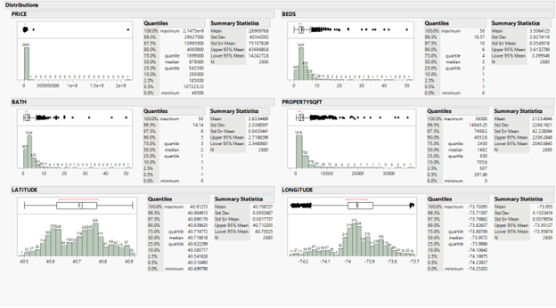
Data Understanding
For Price, all but 2 records were below $29 million, even after the removal of 1,296 instances. After an outlier analysis (K-Nearest Neighbors method with K=5), the two rows were found to be the strongest outliers and were removed.
For Beds, the distribution was nearly symmetric but skewed slightly to the right. 99.5% of homes had fewer than 15 beds, and the median is 3. Baths was similarly distributed, but even more skewed to the right. The median is 2, and 99.5% of homes had 10 baths or fewer.
PropertySQFT was heavily skewed to the right, with 99.5% of homes within 13,088 square feet. The median that came in the initial analysis was 21,842,184.208 sqft and led to further data cleansing. As a result, the median shifted to 1,482.
Latitude appears to have both a local maximum and global maximum. Longitude is skewed slightly to the left. A weak correlation exists between the price, property square feet, and the longitude/latitude coordinates with correlation values of 0.1391, -0.0256, and -0.0585 respectively.
Figure 1: Final Continuous Variable Statistics

Slide 6
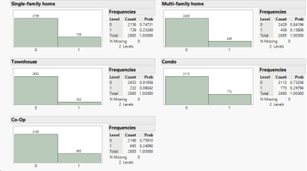
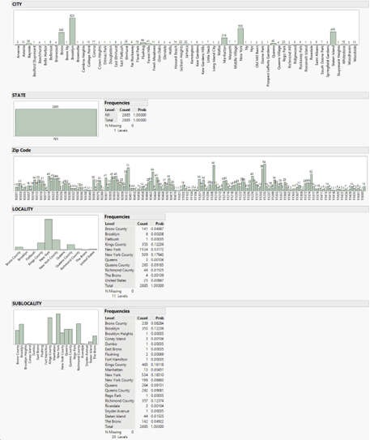
Data Understanding...cont'd
Regarding the types of homes for sale and the distribution of type versus location (more information in the Appendices):
Single-family homes, condominiums, and co-ops all were at around 25 percent share of the distribution.
Most sales by county were in Manhattan (53%) and New York County (17.6%). For City, 28.6% were in Brooklyn, 17.4% were in Manhattan, and 14.5% were on Staten Island.
Richmond County held the highest number of listed single-family homes (245), followed by Kings County (193), Queens County (136), and Bronx County (96). All other sublocalities did not have more than 30 homes listed.
Kings County had the highest number of multi-family (164), followed by Bronx County (113), Richmond County (76), and Queens County (71).
The largest number of townhouses for sale was found in New York County (99), followed by Kings County (74). For both Condos and Co-Ops, New York led, followed by Queens and Brooklyn.
Figure A-2: Nominal Variable Distribution

Slide 7
Data Modeling
Three statistical models were constructed to analyze the relationships within the data. They are:
Least Squares Regression (LSR): was chosen to establish a straightforward relationship between independent variables like property type, number of bedrooms, and square footage, and the dependent variable, which is the price of the properties and to test the performance of the model. (See Table A-4 in Appendices)
Principal Component Analysis (PCA): was used as a technique to reduce the dimensionality of the dataset by identifying the principal components that capture the most variance in the data. This method is beneficial for improving model efficiency and mitigating issues like multicollinearity. (See Table A-5 in Appendices)
Neural Network Models: were developed to capture the non-linear relationships and complex patterns that linear model and PCA might miss. This approach was expected to handle the intricate interactions between variables more effectively. (See Figures A-2, A-3, A-4, and A-5 in Appendices)

Slide 8
Model Evaluation
In evaluating the three models we developed for predicting New York housing prices, we considered a variety of metrics to assess each model’s accuracy, generalizability, and suitability for deployment.
Least Squares Regression (LSR): The LSR model displayed a perfect fit with an R² value of 1.0 (100%) and 0 RMSE, which typically indicates overfitting. The result suggests that while the model could explain all variability within the training set, it might not perform week on unseen data due to its excessive complexity and exact fit to the noise and specific details of the training data.
Principal Component Analysis (PCA): The PCA-based regression model provided an Adjusted R² of only 0.064817 (6.4%) and RMSE of 39,012,725. This model demonstrated limited ability to account for the variance in housing prices and moderate error. This significant reduction in explanatory power compared to the LSR model suggests that while PCA helped in reducing noise and overfitting by focusing on the principal components, it may have also discarded too much useful information.
Neural Network Analysis (Holdback Model): The initial Neural Network model yielded a training R² 0f 0.4413, showing that about 44% of the variance in housing process was accounted for by the model. However, the validation R² was extremely low at 0.0078, indicating poor generalizability to new data, These results pointed to an overfitting issue, similar to the LSR but to a lesser degree. Additionally, RASE was 3,406,790.1 (training) and 69,252,403 (validation), further supporting overfitting.
Neural Network Analysis (Random Seed Models): The second set of random-seed Neural Network model resulting in test R² values of 0.4460 to 0.4642 , better than the Holdback model. Additionally, the Random Seed models provided reasonable 3,117,138 to 3,169, 966.4 test RASE’s, also outperforming the Holdback model. This suggests that overfitting is no longer an issue for these models, as there is consistency for the training and test values. We also saw improvement in –LogLikelihood (lower by 22.2 million compared to the Holdback model) indicating lower entropy and improved accuracy.

Slide 9
Model Evaluation... cont'd
Model | R-Squared | RMSE/RASE
LSR | 1.0 | 0
PCA | 0.064817 | 39,012,725
Neural Network (Holdback Method) | 0.4413 / 0.0078 (Training / Validation) | 3,406,790.1 / 69,252,403 (Training / Validation)
Neural Network (Random Seed, 3 Runs) | 0.4460 to 0.4642 (Test) | 3,117,138 to 3,169, 966.4 (Test)
Table 2: Model Evaluation Metrics Comparison
These metrics informed our decision-making process regarding which model to select for deployment. Despite the high R² and low RMSE achieved by the LSR model, its lack of generalizability made it unsuitable for practical application. The PCA model, while not overfitting, failed to capture enough variance to be useful as a predictive tool. Lastly, the Holdback Neural Network model was not generalizable enough as well.
We have selected the Neural Network model for deployment. The decision to deploy the Neural Network model was driven by its optima balance between accuracy and generalizability, demonstrated by its performance on test data and its R² values. This model has shown it can effectively capture the non-linear relationship that is critical in real estate market analysis. Its superior ability to generalize to new data underscores its suitability for predictive applications in dynamic markets like real estate, highlighting its potential for further refinement to navigate the complexities of this sector effectively.

Slide 10
Conclusion
The analysis confirmed that variables such as property type, size and locations are pivotal in determining housing prices.
The Random Seed Neural Network model, with its ability to handle complex variable interactions, provided the best framework for predicting prices based on these factors.
This Neural Network model allows Sunshine Real Estate to segment the market effectively, identifying high-value areas and property types that promise the best returns on investment.
In order to most effectively deploy this model, it must be integrated into Sunshine Real Estate’s operational systems to provide continuous real-time analytics. Regular model updates need to incorporate new data and market trends, ensuring the model remains effective and accurate. Periodic evaluation of the model and accuracy of the expected pricing of homes must be undertaken, especially in periods of economic turmoil or unexpected occurrences, so that observations can be made to improve the model in the future.

Slide 11
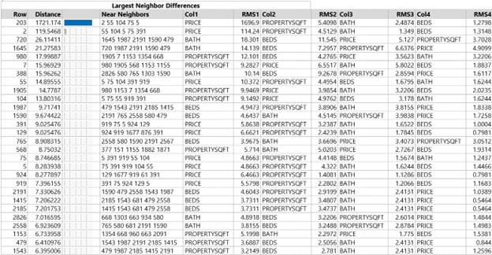
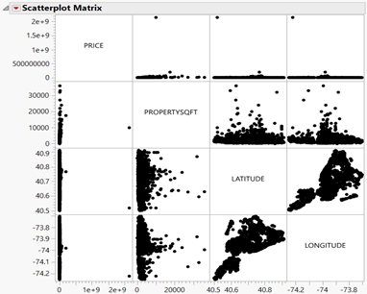
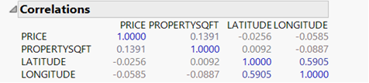
Appendices
Table A-1: Largest Outliers for K-Nearest Neighbors
Figure A-1: Variable Scatterplots (Continuous)
Table A-2: Variable Correlations (Continuous)

Slide 12
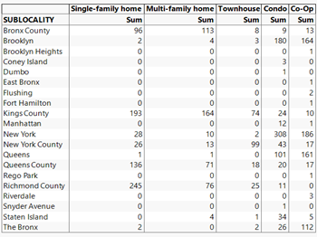
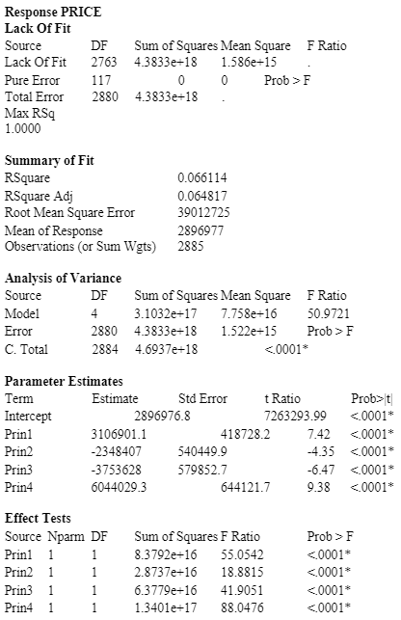
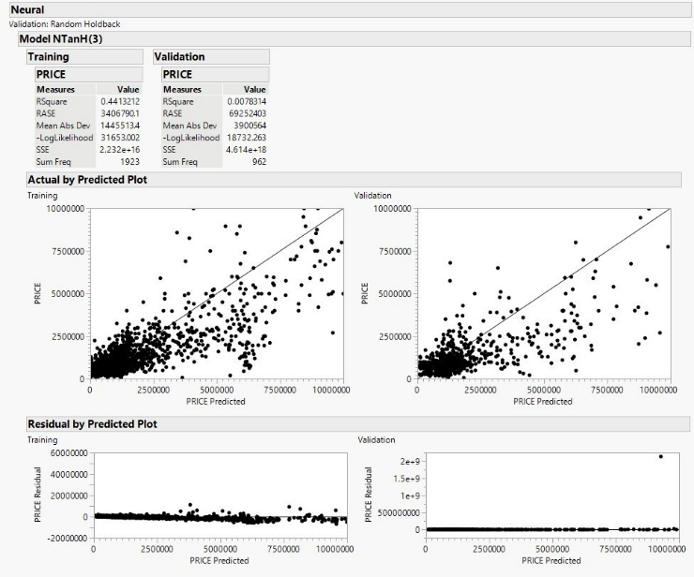
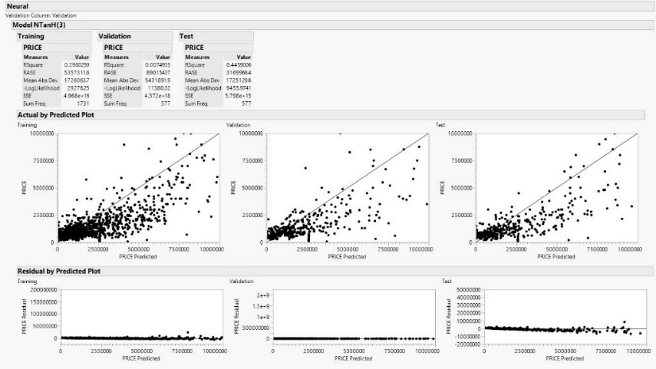
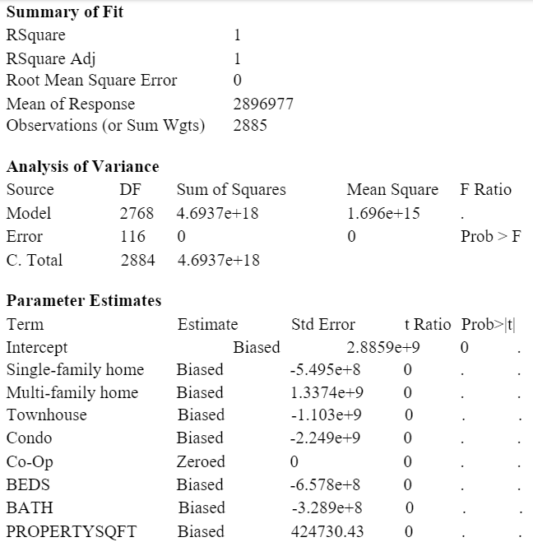
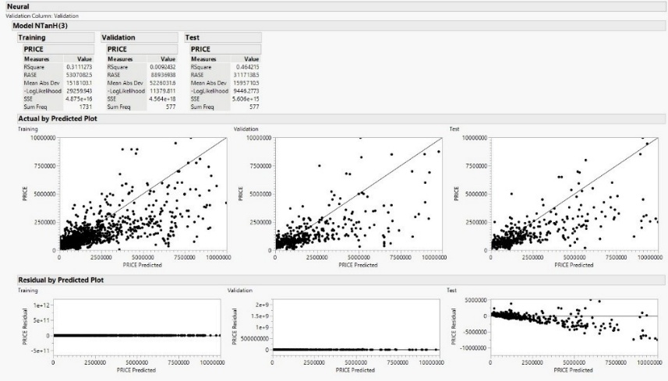
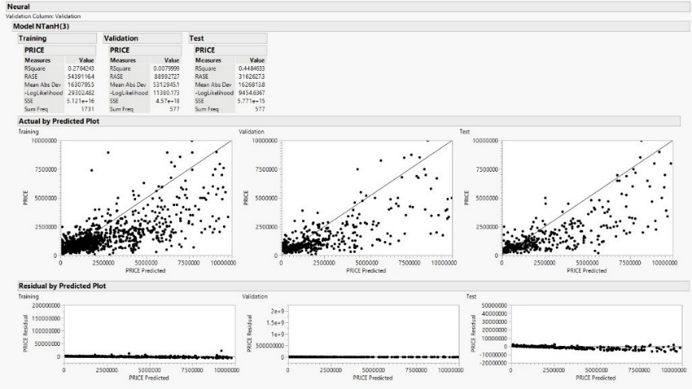
Appendices (Cont.)
Figure A-4: Model Results – Random Seed Neural Network Run 2
Table A-3: Home Type per NYC Sublocality
Figure A-2: Model Results – Holdback Neural Network
Table A-5: Model Results - PCA
Figure A-4: Model Results – Random Seed Neural Network Run 3
Figure A-3: Model Results – Random Seed Neural Network Run 1
Table A-4: Model Results – Least Square Standard

