Slide 1
Final Presentation
Emma Givens and Anna Schmitt

Slide 2
Problem Statement
AirBnB has over 150 million users worldwide. Many people are purchasing properties to turn them into AirBnBs and utilizing them as their main source of income
Goals:
  Provide insights that can maximize the price of a Boston AirBnB
  Create a model capable of predicting price from various basic AirBnB datapoints

Slide 3

Data Description
Our data source was obtained through Kaggle
Data originated from a data scrape of the AirBnB website in 2016 with a focus of rental properties in Boston, MA.
After initial data cleaning there remained 49 attributes with 2,512 records

Slide 4
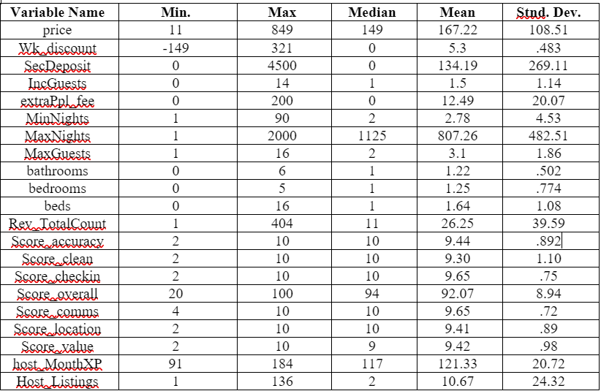

Descriptive Analytics
We collected the mean, median, minimum, maximum, and standard deviation for each attribute

Slide 5
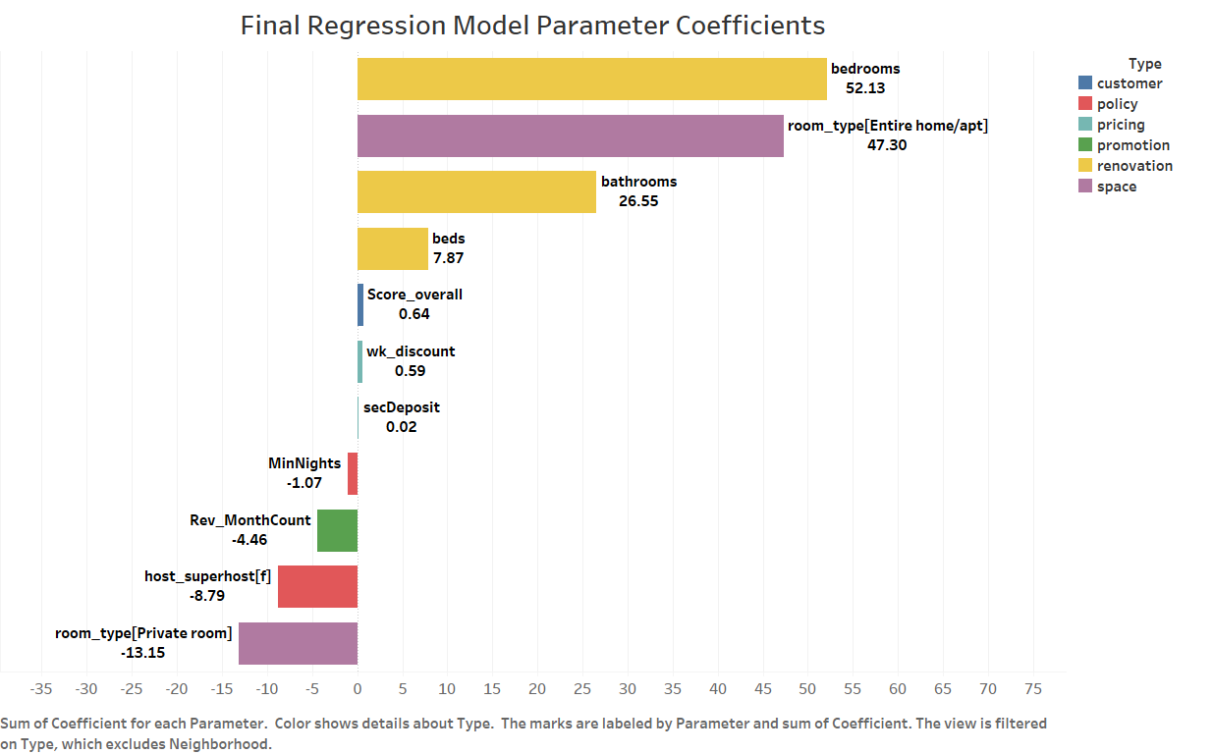
Regression Model
Table 1 <below>: Model Predictors and Statistics
 | Initial Model (M₁) | Final Model (M_{F})
Predictors | 14 var., 108 param. | 12 var., 22 param.
R² | 0.7053 (70.53%) | 0.6955 (69.53%)
RMSE | 58.90 | 61.20
Test | M₁ | M_{F}
F-Test (Prob>F) | Pass | Pass
T-tests (Prob>|t|) | 2 Failures | Pass
Multicollinearity | 2 Failures | Pass
Residuals | Pass | Pass
Table 2 <above>: Statistical Significance
*EXCLUDES Neighborhood Variables
Notes:
To ensure the creation of a statistically significant final model, our approach to model development was iterative. We created an Initial Model (M1) by performing linear regression (using Fit Least Squares). This model considered 14 predictor variables with a total of 108 parameters
Model optimization was driven by the goal of increasing accuracy by lowering the Root Mean Squared Error (RMSE) to $60.00 or less, while maximizing the goodness of fit by creating a model with sufficiently high Adjusted R-squared (R²), at or above 0.70.
Model performance was adequate with an Adjusted R² of about 0.7179 and Root Mean Square Error (RMSE) of 58.90, as shown in Table 1.
The R² indicates that 71.79% of variation in price is explained by the model. This R² value exceeds a self-set threshold of 70% set on behalf of the AirBnB owners to ensure they do not invest in changes that may not actually contribute to a justifiable price increase.
The RMSE indicates that the average deviation between ‘actual’ price and predicted price was $58.90. Again, this met a self-set threshold (RMSE ≤ 60)
Although M₁ demonstrated satisfactory explanatory power and predictive accuracy, statistical significance was weak in terms of parameter estimation, as seen in table 2.
In our final model (denoted MF), We remediated these issues by converting the 2 variables that failed the t-test into indicator variables and by excluding the 2 predictors that demonstrated multicollinearity
MF had a slightly lower R2 of 0.6956 and slightly higher RMSE of ~61.20. Because statistical significance is vital in legitimizing a model and these values were relatively close to the desired threshold values (R2 ≥ 0.7 and RMSE≤60.00) this model is considered acceptable for use.
That said, our recommendation is to attempt to optimize the model through data mining techniques to get these measures within the desired range.
In respect to the business problem, M_{F} also produced findings that are helpful in addressing Airbnb hosts’ question about what modification(s) may allow them to raise their price
The figure above depicts the relative impacts of various types of Airbnb qualities on the expected nightly price.
Variables with longer bars have a greater magnitude of effect on price.
The leftmost 14 parameters have a negative effect on price, while the right-most 8 relates positively with price.
Color coding corresponds with what type of change the airbnb host would need to make
For example, Based on the graph, renovating to add more bedrooms, more bathrooms, or more beds would be wise actionable in=improvements on the part of the airbnb hosts.
On the other side, we see that FAILING to become a superhost negatively effects what they can charge. Therefor, in pursuit of more revenue, a host may want to initiate this process to become a superhost.
These findings are a sampling of results extracted from this model, but the expectation is that Airbnb hosts will customize and explore the model as appropriate for their own circumstances.

Slide 6
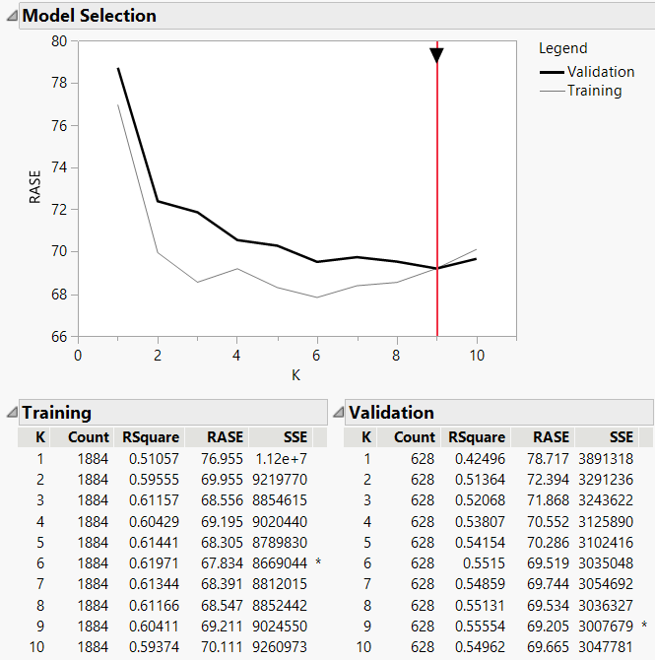
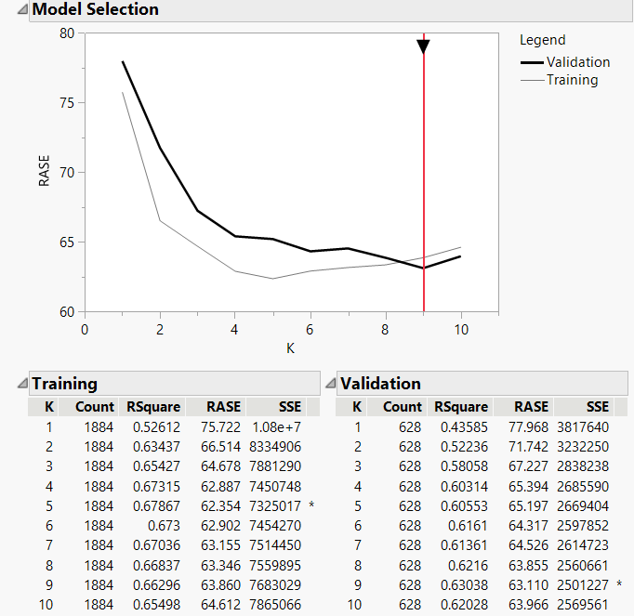
K-Nearest Neighbor Model
Initial (K-NN₇₈ ) Final (K-NN₂₂ )
Notes:
Given the final regression model is able to answer question 2 of the problem description, our intent in using K-Nearest Neighbors (K-NN) was to provide a better model for addressing question 1: “what can I charge for my rental?”. K-NN is a Non-parametric Supervised learning technique. Because our group only has 2 team members, we were only required to use two suprevised learning techniques; We chose this as our second because it works well on non-Linear data. Although the Linear Regression Model had adequate fit, we thought it was wise to try applying a model that can capture more complex patterns and relationships in case our data had non-linear patterns that we just had not detected yet.
Since K-NN predictions are made based on similarity between data points, creation of this model was straightforward because testing the significance of predictors was unnecessary. That said, as previously stated, the final K-NN model did consider the same 22 parameters as M_{F}, but only because these predictors happened to produce a model that performed better than the initial K-NN model (K-NN₇₈) which considered all 78 parameters. This is t o be expected as higher dimensionality often results in degraded KNN performance.

Slide 7
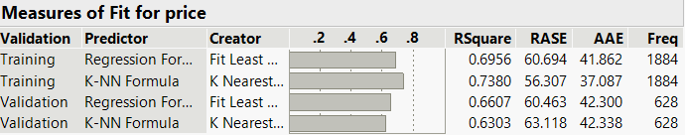
Conclusion
Model Comparison Findings indicate that in Training, K-NN₂₂ had performance measures that were, on average, about 8.9% better than M_{F}.
When tested on the Validation set, M_{F} exhibited performance indicators that were on average, about 3.10% better than K-NN₂₂
Therefore, unless K-NN₂₂ is improved, the Final Regression Model should serve as the tool by which Airbnb hosts optimize their pricing.
  As non-parametric technique, K-NN will never be able to provide insights on the relative importance of different parameter types on estimated pricing.
Notes:
We leveraged the JMP Model Comparison platform to evaluate each model’s accuracy and error rates to determine their relative effectiveness in predicting outcomes. As supported by the Output on the slide,
within the Training set, K-NN₂₂ exhibited the following statistics: R²=0.74, RASE=56.31, and AAE=37.09, indicating that in training, K-NN₂₂ did outperform M_{F} which had R²=0.69, RASE=60.69, and AAE=41.86).
However, when tested on the validation set, K- NN₂₂ performance measures worsened by an average of 13.44%.
In validation K-NN₂₂’s R²=0.63, RASE=63.12, and AAE=42.32, while M_{F} performance remained very similar to what it exhibited on the training set (worsening by just 2.24% on average).
When M_{F} was applied to validation data, RASE actually improved by 0.23 (dropped to 60.46), while R² decreased by just .035 (R²=0.6607), and AAE increased by only 44 cents (AAE=42.30).
Therefore, although K-NN₂₂ showed promise as a well-fit, accurate model based on training results alone, it’s poor performance when used against validation data suggests overfitting and indicates that it may perform more poorly than M_{F} when applied to the Airbnb hosts’ actual data.
To verify this assertion, we recommend training and validating the models against different (ideally larger and more recent) datasets. If more data is used for training, then it may be possible to produce a model with minimal overfitting capable of outperforming M_{F} in both training and validation.
That said, even if a better, more consistent K-NN Model could be developed, it would not fully meet the business problem. Given it is a non-parametric technique, it can not allow Airbnb hosts to explore the effect of specific parameters on price, whereas the Final Regression Model did [as shown by our graph of parameter estimates].

Slide 8
Future Considerations
With more time, running more models may result in a better response
Explore data mining more current data to see the trends over time
Exploring more locations to see if trends are consistent across locations

Slide 9
Sources
https://www.kaggle.com/datasets/airbnb/boston

