Slide 1

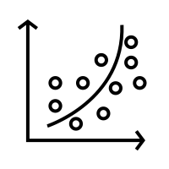


Predictive Modeling of Type 2 Diabetes in the Pima Indian Community
By: Adriano Lima e Silva, Sonya Ali, Haymanot Berhe
Group 1
BIT 5534 – Spring 2024

Slide 2
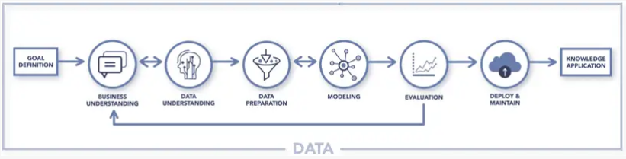
Introduction
Context:
  Diabetes as a global issue with a specific impact on the Pima Indian community.
Need:
  Importance of advanced predictive models for early detection.
Objective:
  To develop and refine predictive models to identify early diabetes risks

Slide 3
Business Understanding
Problem Definition
Objective
Expected Results
High incidence of type 2 diabetes in the Pima Indian community
Need for early detection and proactive healthcare strategies
Lack of personalized diabetes risk assessment tools
Develop predictive models to identify risk factors for diabetes
Enable early intervention and personalized healthcare plans
Utilize data science to inform and transform community health practices
Increase in early detection rates of diabetes
Improvement in individualized patient care
Strengthening of community health through data-driven decisions

Slide 4
Data Understanding
Biometric Data
Historical Data
Outcome Flags
Glucose
Blood Pressure
Skin Thickness
Insulin
BMI
Pregnancies
Diabetes Pedigree Function
Age
Outcome (Diabetes Outcome)

Slide 5
Data Preparation
Initial State:
768 records with significant missing values.
Actions Taken:
Removal of records with missing data, resulting in 336 complete records.
Imputation and removal of missing values in key measures
Dataset Balancing:
Addressing imbalance between diabetic and non-diabetic cases through undersampling.
Notes:
HB

Slide 6
Modeling Approach
Framework:
Adoption of the CRISP-DM methodology.
Models Employed:
Logistic Regression
Neural Networks
K-Nearest Neighbors (k-NN)
Notes:
HB

Slide 7
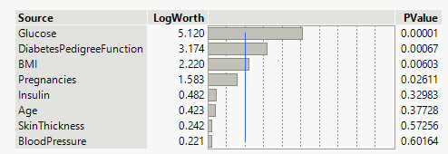
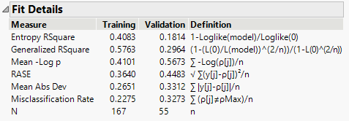
Model 1
Logistic Regression
Predictors:
Glucose, Diabetes Pedigree & BMI Function as significant indicators.
Performance:
Simple predictive power but requires cautious interpretation due to potential overfitting.
Notes:
HB

Slide 8
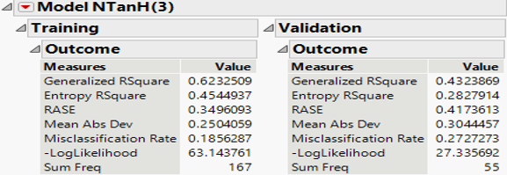
Model 2
Neural Networks
Strengths:
High capability in capturing complex relationships and variances.
Limitation:
Suffered from overfitting, indicating the need for parameter tuning and validation.
Notes:
HB

Slide 9
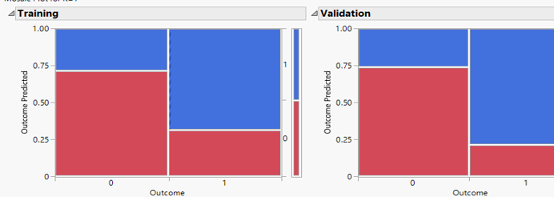
Model 3 k-Nearest Neighbors
Accuracy:
Demonstrated high effectiveness in classifying outcomes.
Application:
Effective in capturing nuanced patterns crucial for accurate predictions.
Notes:
HB

Slide 10
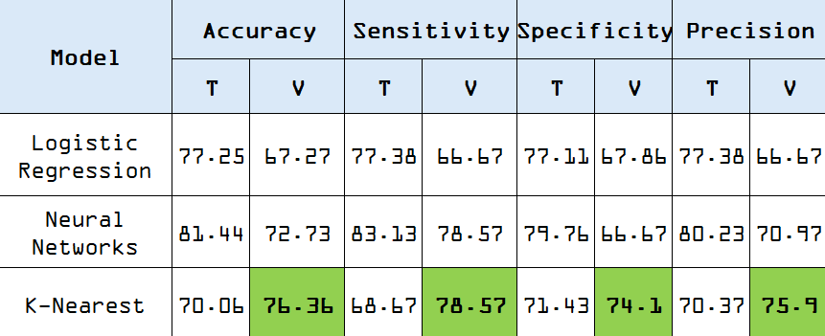
Evaluation
Logistic Regression
Strong initial predictive power; potential overfitting noted
Training AUC: 0.894 | Validation AUC: 0.803
Neural Networks
High explanatory power with a drop in validation
Training R-square: 0.623 | Validation R-square: 0.432
K-Nearest Neighbors (k=1)
High validation accuracy
Training Accuracy: 70.06% | Validation Accuracy: 76.36%
Common Insights:
Glucose is a key predictor in diabetes outcomes
Overfitting is a concern across models, suggesting a need for refined model tuning

Slide 11
Deployment
Rollout Plan:
Integrate model into health systems for immediate diabetes risk assessment.
Partner with medical staff for smooth technology adoption.
Empowerment & Support:
Provide targeted training on model usage and decision-making.
Set up a support system for continuous guidance.
Oversight & Updates:
Establish routine model accuracy checks and performance audits.
Update models with new data and evolving standards.

Slide 12
Conclusion
Key Insights:
Identified critical diabetes predictors; models showed varying predictive strengths.
Healthcare Impact:
Shift towards early, personalized diabetes interventions in the Pima Indian community.
Next Steps:
Refine and expand model validation for broader application.
Big Picture:
Paves the way for predictive healthcare, offering a more proactive approach to managing diabetes risks.

