Slide 1

Predicting hit songs
Anusha Kallige Bhasker, Jane Cys, Casey Wade Gary

Slide 2




Business problem and description
The music industry had an annual revenue of $25.9 billion in 2021. We will predict which attributes of a particular song can be used to determine whether it will be a hit – or a flop.
Project Objectives
Determine which song attributes will predict whether a song becomes a hit.
Determine which song attributes might predict whether a song will be a flop.
Notes:
What makes a song more likeable? Are there common attributes that hit songs have in common? Is it possible to predict whether a song will be a hit or a flop based on these attributes alone? These are the questions our project sought to answer. The music industry had an annual revenue of $25.9 billion in 2021. A record executive has limited resources to sign new artists and must choose which songs in their catalogues to promote. Through predictive analytics we have attempted to build a tool for better decision making in the music industry by creating a predictive model that can proactively identify hits and flops. An artist has limited time to create new music. Through our analysis we have attempted to capture the most important attributes for a hit song that can guide their creative processes and song choice.

Slide 3

Data Description
The dataset focused on songs from the 1990s, as identified via a Spotify Web API, and included 5,521 observations. It was obtained from Kaggle.com.
The dataset had 19 musical attributes – 3 categorical variables and 16 continuous variables.
The target variable (which is named target) is binary; a 1 indicates a hit and a 0 indicates a flop
Categorical Variables
Track Artist Uri Danceability Energy Key Loudness Mode Speechiness | Acousticness Instrumentalness Liveness Valence Tempo Duration_ms Time_signature Chorus_hit Sections
Notes:
The 2010s saw a massive wave of 1980’s nostalgia in the US full of period movie remakes and the return of feel-good pop music. For our project we have decided to get ahead of the next wave and focus on 1990’s song data.

Slide 4
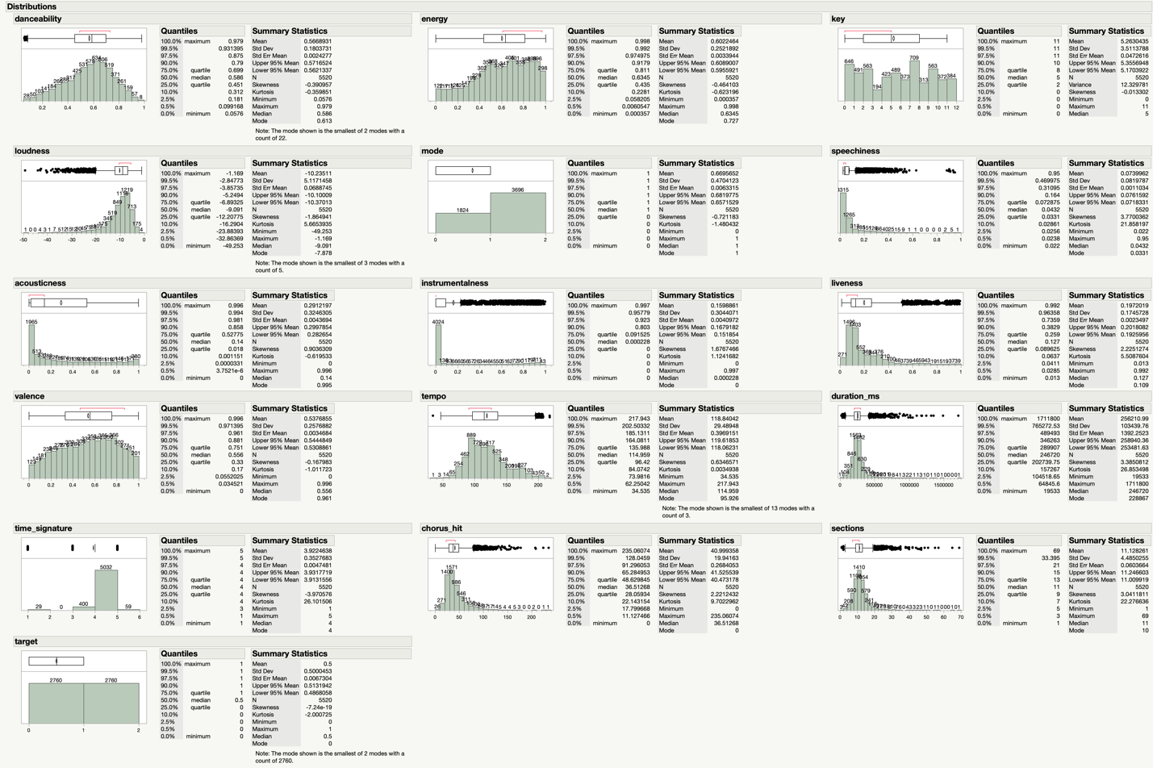
Data preparation
Clean data set. No values missing and all data appeared as expected.
Histograms were created to look at patterns in individual variables.
Out of 5,520 overall observations only 10 outliers were identified across all variables. We left them in the model as such a small number was unlikely to cause significant impact.

Slide 5
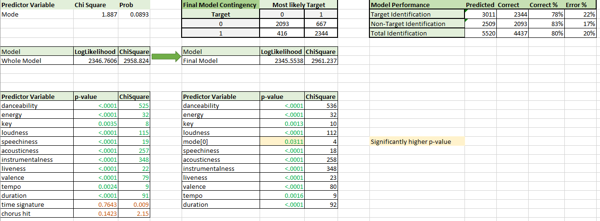
Logistic regression
Model 1
Our logistic regression model showed strong predictability with 9 of 13 predictor variables having a p-value of less than .0001. Three more predictors had p-values below our alpha of .05 so 12 total continuous variables were included in our Final Logistic Model.
This Final Logistic model had an RSquare value of .387 and correctly predicted 2,344 of 2,760 hit songs, yielding an Accuracy rate of 80%, a Sensitivity of 84%, and a Specificity of 75%.

Slide 6
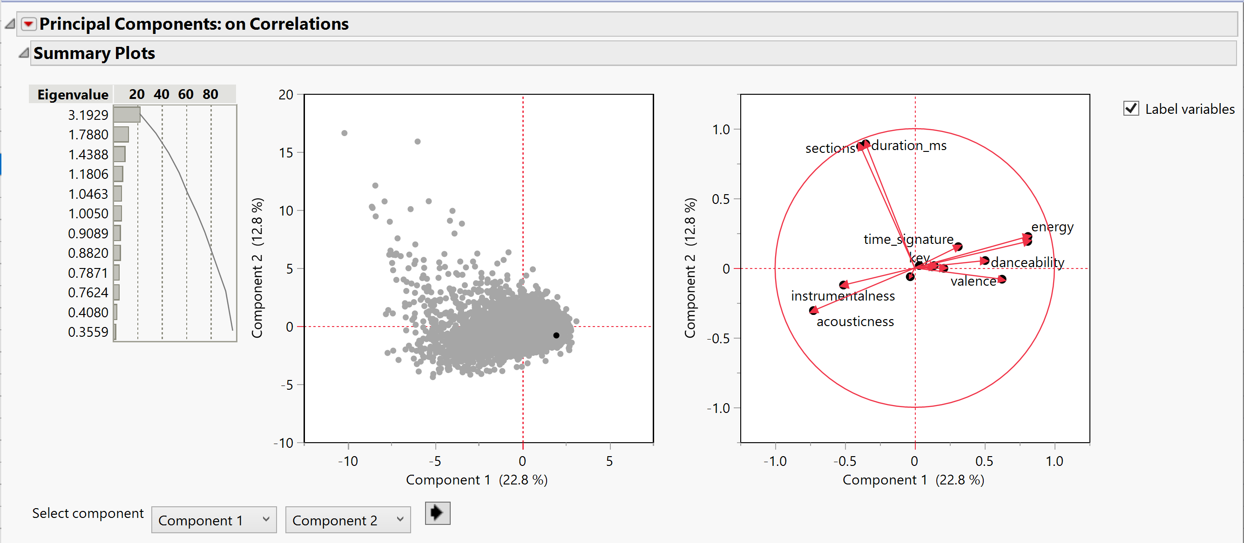
Principal Component Analysis
Model 2 – Slide 1
All continuous variables in the dataset were used to conduct the Principal Component Analysis and break the dataset up into predictive components.
Eigenvalue of the first PC was 3.1929 and explains 22% of the data variation. Eigenvalue of the second PC was 1.7880 and explains just over 10% of the data variation.
The top 10 components combined accounted for only 58% of the data variance so PCA did not offer a simplification of the model over the logistic regression model in this case.
We saved the top 10 components to the dataset for our use in regression.

Slide 7
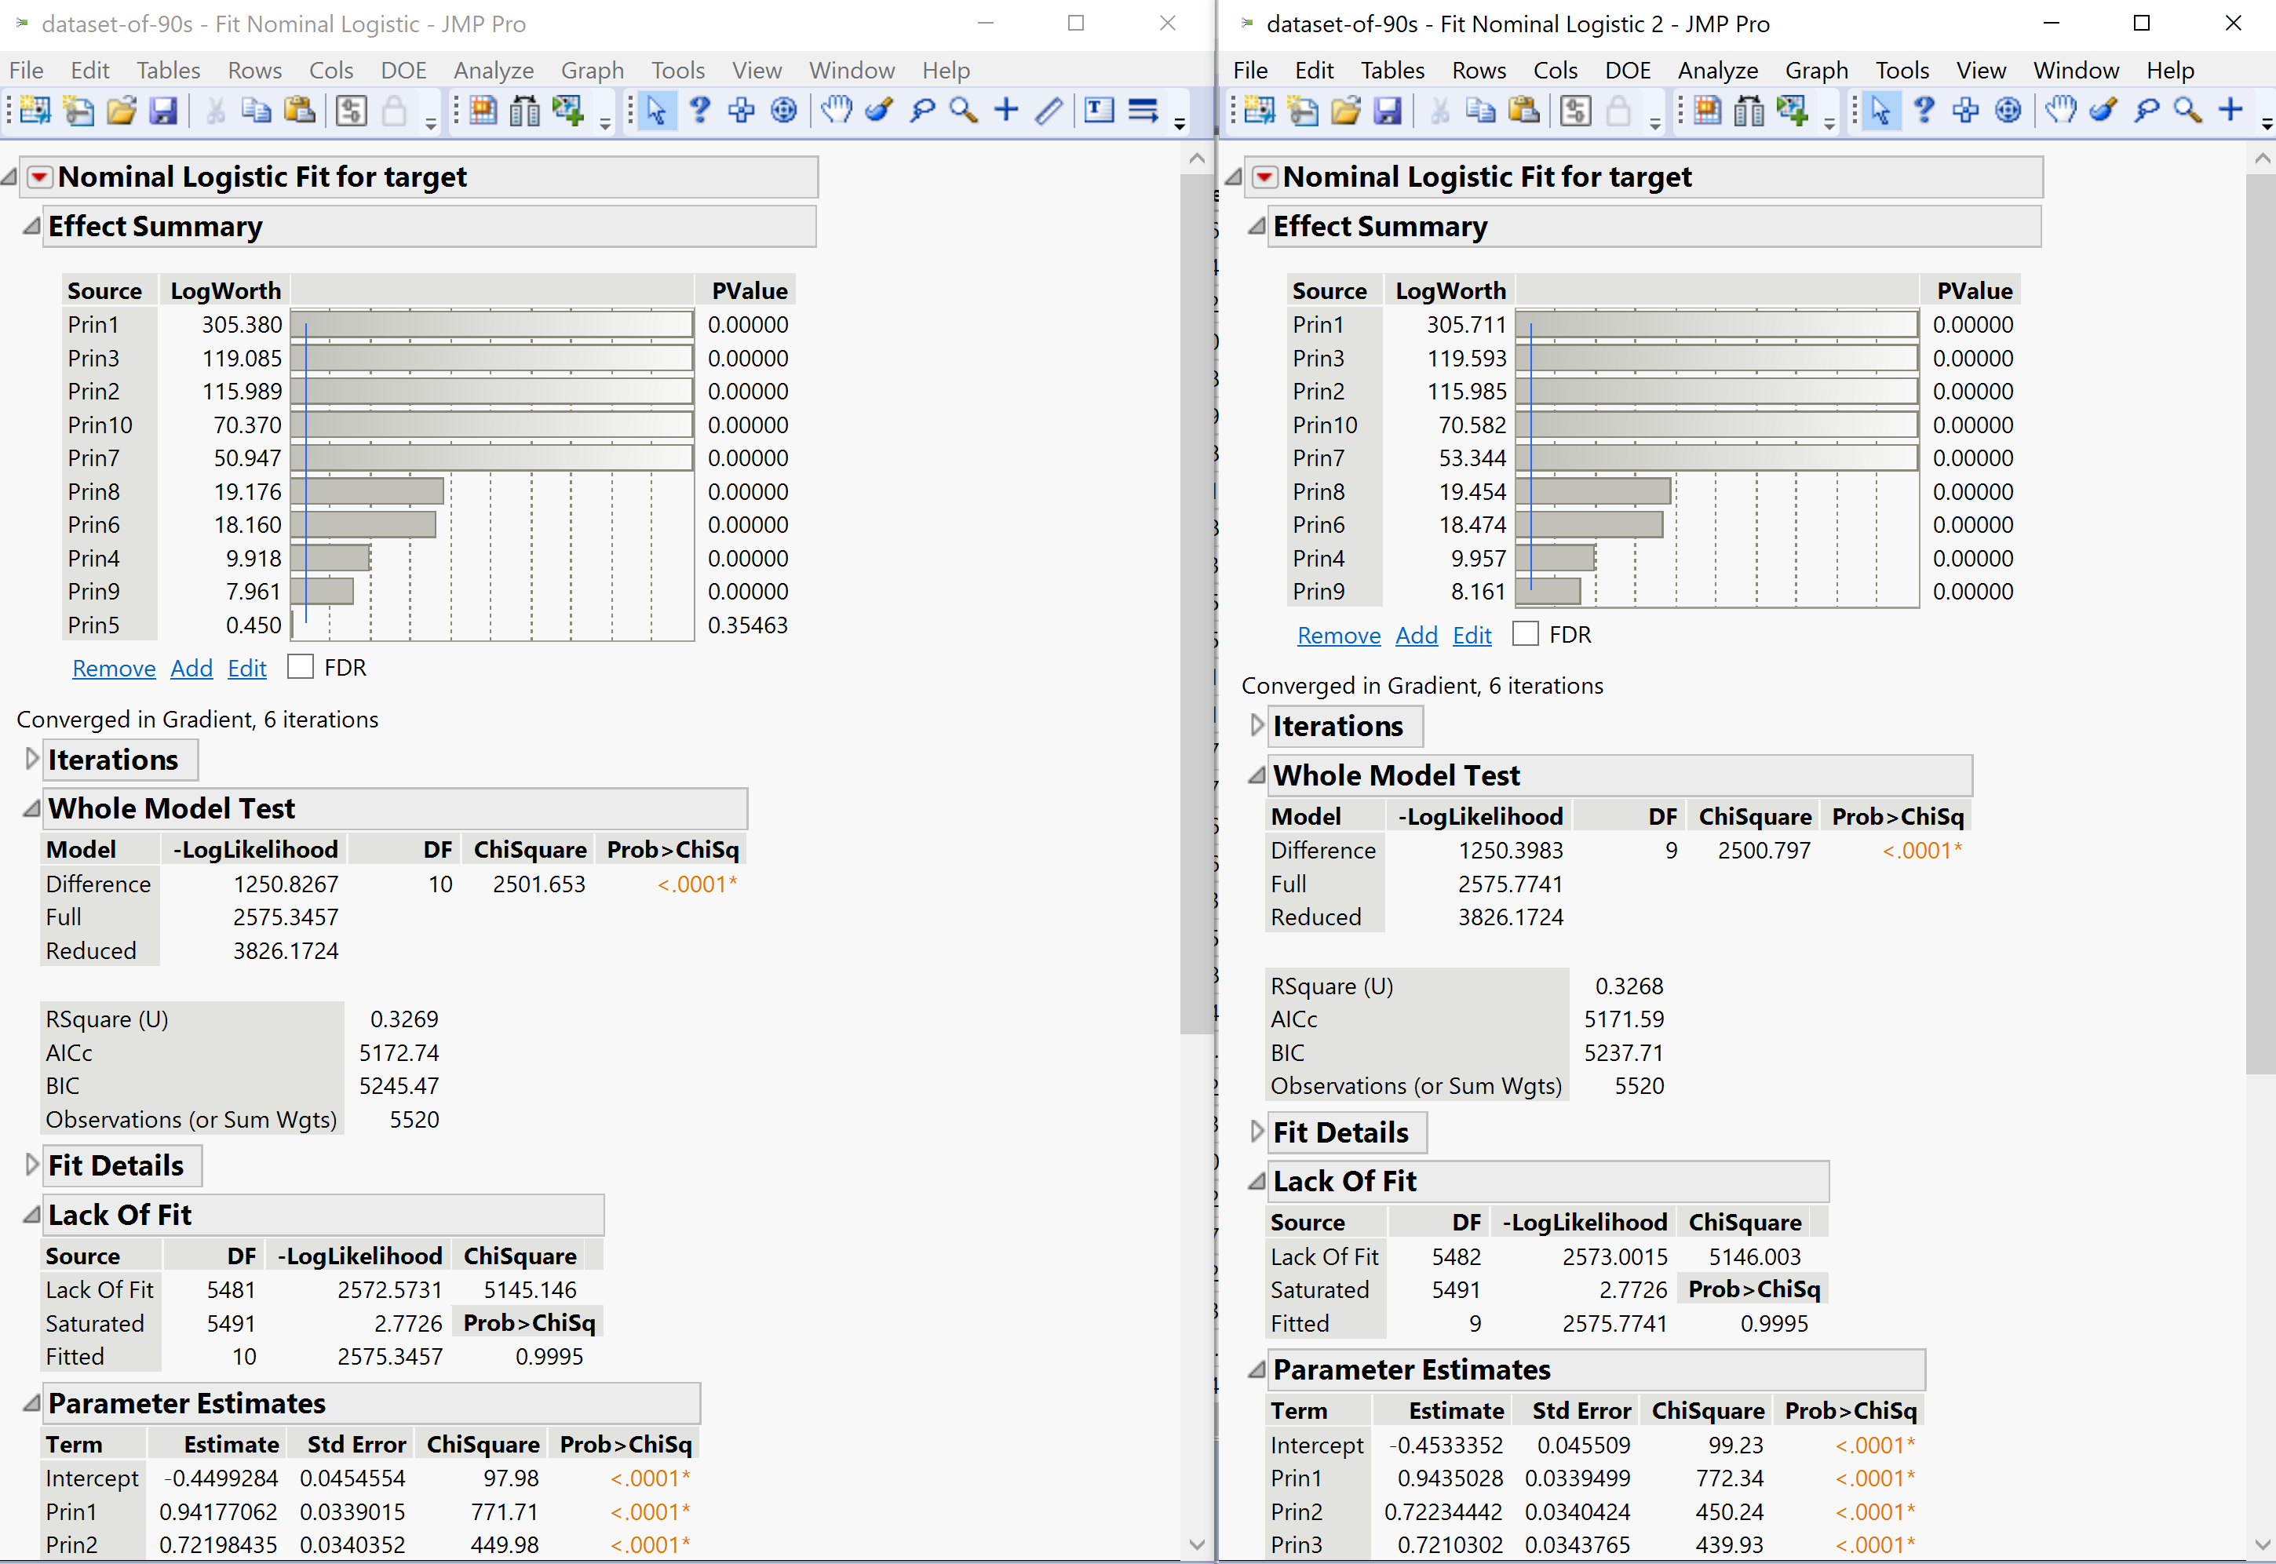
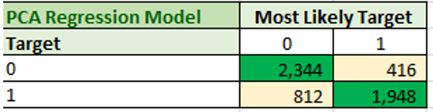
Principal Component Analysis
After running logistic regression with all 10 components we attempted to refine the PCA model by removing the lowest performing component, PCA 5.
The RSquare value for this PCA model was .3268 or only 32% of variance predicted compared with an RSquare of .387 for the final Logistic Regression model.
The PCA model identified 1,948 of 2,760 hit songs, yielding an Accuracy rate of 77%, a Sensitivity of 70%, and a Specificity of 84%.
Model 2 – Slide 2

Slide 8
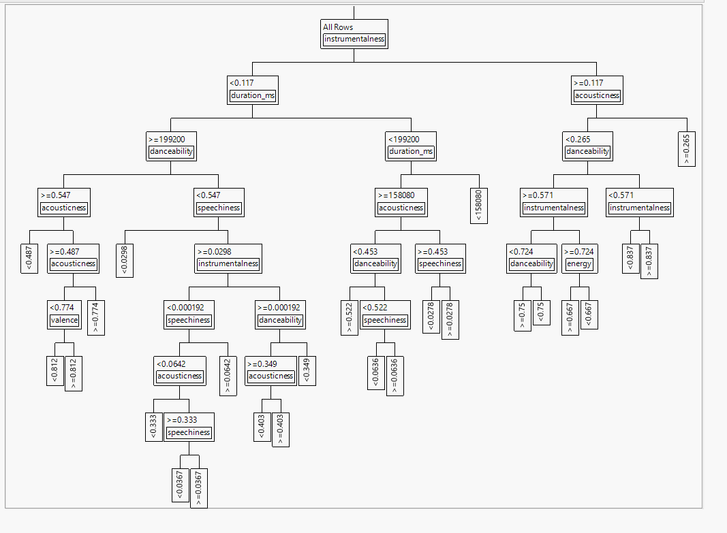
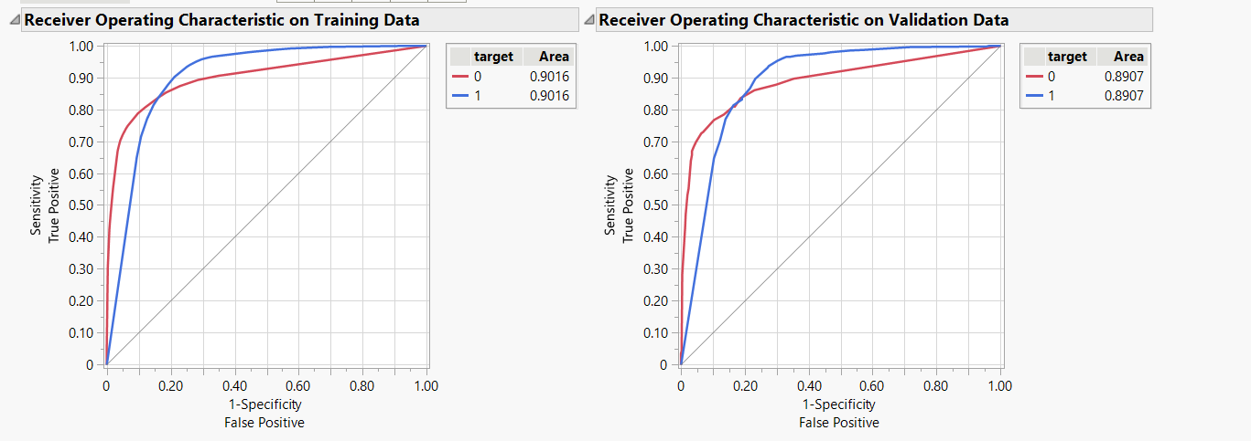
Decision tree
The decision tree had 24 decision points to predict whether a song is a hit or not.
The model had an R-square value of 0.465 on the training set, which indicates it explains 46.5% of the variability in the target variable.
According to the analysis, the feature with the highest contribution to predicting hit songs is "instrumentalness" with a G^2 value of 1031.11553 and a portion of 0.3595.
The ROC is the same for training and validation data and shows the model has good predictive value.
Model 3

Slide 9
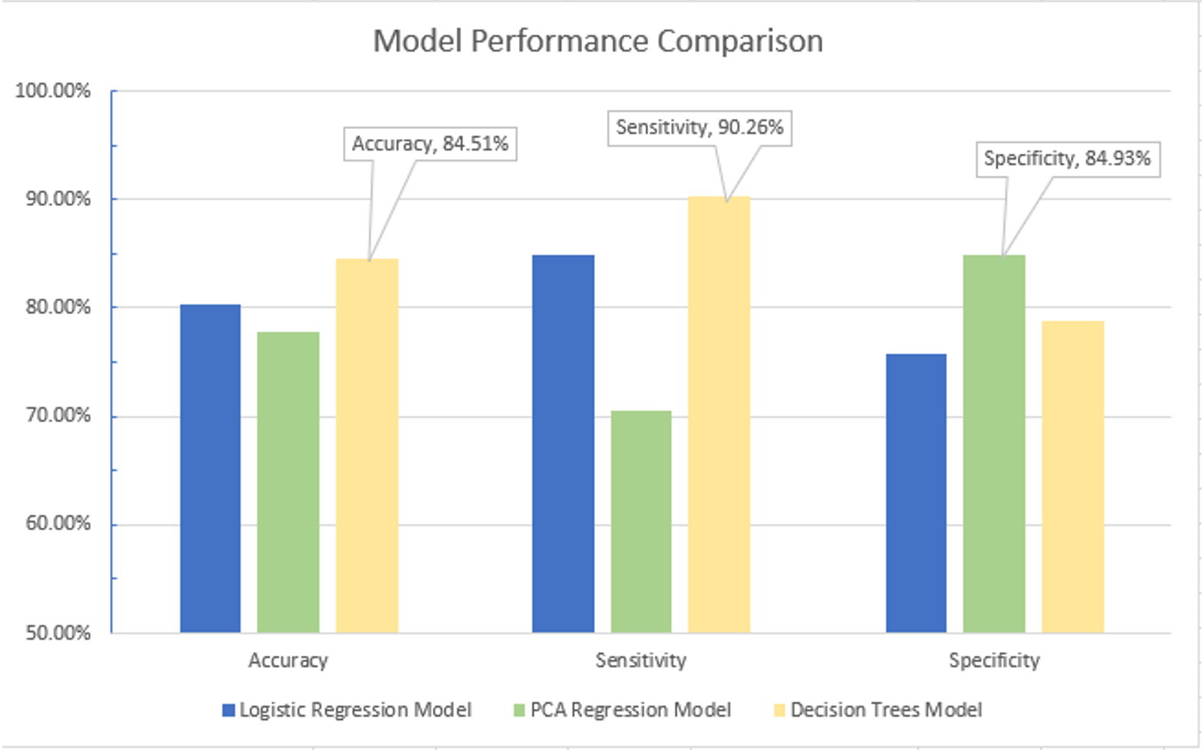
Model Comparison
Model Name | R Square
Logistic Regression | 0.387
Principal Component Analysis | 0.326
Decision Tree | 0.465
Notes:
To compare the performance of each model, decide on practical applications, and make our final model selections we compiled confusion matrices for each of the three models and used the data to calculate performance statistics for each. The confusion matrices are included in Appendix Figure 13 and the Performance Statistics are included in Appendix Figure 14. First we look at overall Accuracy and we can see that the Decision Tree model won out with 84.5%, followed by the Logistic Regression model at 80.3%, and the PCA model trailing at 77.7%. Sensitivity – or the true positive rate – scores are proportional with 90% for Decision Trees, 84% for Logistic Regression, and 70% of the PCA. Interestingly when we look at the Specificity – or the models ability to predict negative events (flops in our case) – we see the the PCA model scored the highest with almost 85% while Decision Trees and Logistic Regression were not as effective at predicting flops.

Slide 10

ConclusionS
For the purpose of identifying hit songs we select the Decision Tree model with it’s high overall Accuracy and particular 90% Sensitivity for picking hits.
For identifying flops or non-hits the PCA model proved to have the highest Specificity (6% higher than the DT model).
To operationalize we would recommend a combination method with both models making independent predictions for hits and flops and a final prediction based on those results.
In general, the most valuable predictors of a hit song in our dataset were danceability, acousticness, and instrumenatlness.
Notes:
For the purpose of identifying hit songs we select the Decision Tree model with it’s high overall Accuracy and particular 90% Sensitivity for picking hits. The relative high performance of this model tells us that the relationships between these factors are not simply linear and more complicated than the logistic regression models can capture. It is likely that predictable factors differ between genres or musical styles and the Decision Trees model is able to capture some of this variability even without having those categorical distinctions available. However, for identifying flops or non-hits the PCA model proved to have the highest Specificity (6% higher than the DT model) and so to operationalize our findings we would recommend a combination of both models with the Decision Tree model issuing a Hit Prediciton, the PCA Regression model issuing a Flop Prediction – and the final prediction being based on the combination of the two model predictions. For example for any given song the results could be HIT PREDICITON: HIT, FLOP PREDICTION: NO FLOP, OVERALL PREDICTION: LIKELY HIT. Music producers could objectively provide data elements for their songs in progress to the model and use the overall predictions to decide which tracks to release first as singles.
Over the course of this project we were also able to identify that the most powerful predictive components of hit songs in the 90s were danceability (ChiSquare = 525 in LR, 15% Column Contribution in DT), instrumentalness or the degree to which the song contains no vocals (ChiSquare = 348 in LR, 36% Column Contribution in DT), and acousticness or the degree to which the song uses acoustic instruments (ChiSquare = 257, 15% Column Contribution in DT) as all three factored heavily in our logistic regression and decision tree models. So in general for companies looking to capitalize on the nostalgia of the 90’s sound to hit the top of the charts with a hit song we can confidently recommend they invest in groups that make music that is highly danceable, highly vocal, and non-acoustic. As a general guideline this alone would increase their probability of landing a hit song and could guide their business decisions.

