Slide 1

BIT 5334 Final Project
Nelaje Branch, Derrell Joppy, Ariana Missar

Slide 2

table of contents
01
02
03
Business Problem
Data Preparation & Transformation
Summary statistics
04
05
Analytical Methodologies
Conclusion

Slide 3
Business Problem & Interesting Questions
Nedear Vineyard and Winery is an up and coming wine distributor, with a goal to modernize the wine industry using E-Commerce. As we dive into the wine making process, we are investigating the physicochemical properties of various red & white vinho verde to understand how we can provide the best quality wines to our customers and distributors.
Questions for Investigation:
  Which properties most greatly impact the quality of vinho verde?
  Which physicochemical properties should we modify to get the best results?
  Which properties are most highly correlated with each other? Removal of one quality can adversely impact another & the resulting quality.
  Do our red or white wines tend to have higher quality?

Slide 4

The data and preparation
White and Red
Size
Preparation
Predictor
Two datasets containing information about red and white vinho verdes
A total of 6,497 combined observations and 13 variables used for analysis
Variable Type was added to distinguish between red and white.
Rating variable to split between high and low dummy variables

Slide 5
Summary Statistics
Independent variables:
Fixed Acidity:
Minimum: 3.8
Maximum: 15.9
Average: 7.22
Volatile Acidity:
Minimum: 0.08
Maximum: 1.58
Average: 0.34
Citric Acid:
Minimum: 0
Maximum: 1.66
Average: 0.319
Residual Sugar:
Minimum: 0.60
Maximum: 65.8
Average: 5.44
Chlorides:
Minimum: 0.009
Maximum: 0.611
Average: 0.056
Free Sulfur Dioxide:
Minimum: 1
Maximum: 289
Average: 30.52
Total Sulfur Dioxide:
Minimum: 6
Maximum: 440
Average: 115.7
Density:
Minimum: 0.987
Maximum: 1.039
Average: 0.995
ph:
Minimum: 2.72
Maximum: 4.01
Average: 3.219
Sulphates:
Minimum: 0.22
Maximum: 2
Average: 0.995
Alcohol:
Minimum: 8
Maximum: 14.9
Average: 10.491
Wine Type & ranking distribution
24.6%
Red Wine
75.3%
White Wine
36.7%
Low Ranking
63.3%
High Ranking
Variable Breakdown:
Target Variable: Ranking
  Binary, Categorical, Nominal
Predictors:
  Numerical, Continuous:
    Fixed Acidity, Volatile Acidity, Citric Acid, Residual Sugar, Chlorides, Free Sulfur Dioxide, Total Sulfur Dioxide, Density, pH, Sulphates, Alcohol
  Categorical, Nominal, Binary:
    Type

Slide 6
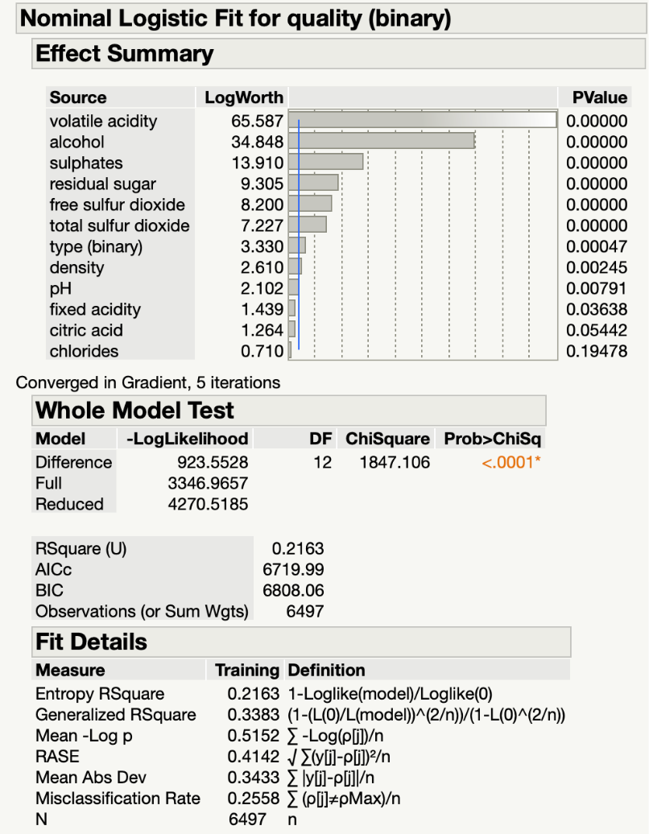
LOgistic Regression
Results:
R^2: 0.2163
RASE: 0.4142
Y = 128.5984 - 0.3305*Type + 0.1060*Fixed Acidity - 4.7780*Volatile Acid + 0.1198*Residual Sugar + 0.0147*Free Sulfur Dioxide - 0.0057*Total Sulfur Dioxide - 139.8185*Density + 0.7878*pH + 2.0056*Sulfates + 0.8048*Alcohol

Slide 7
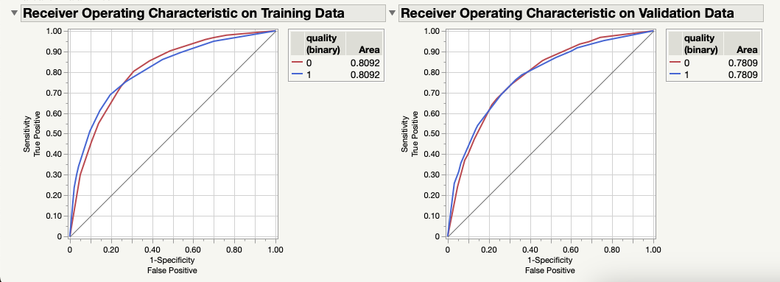
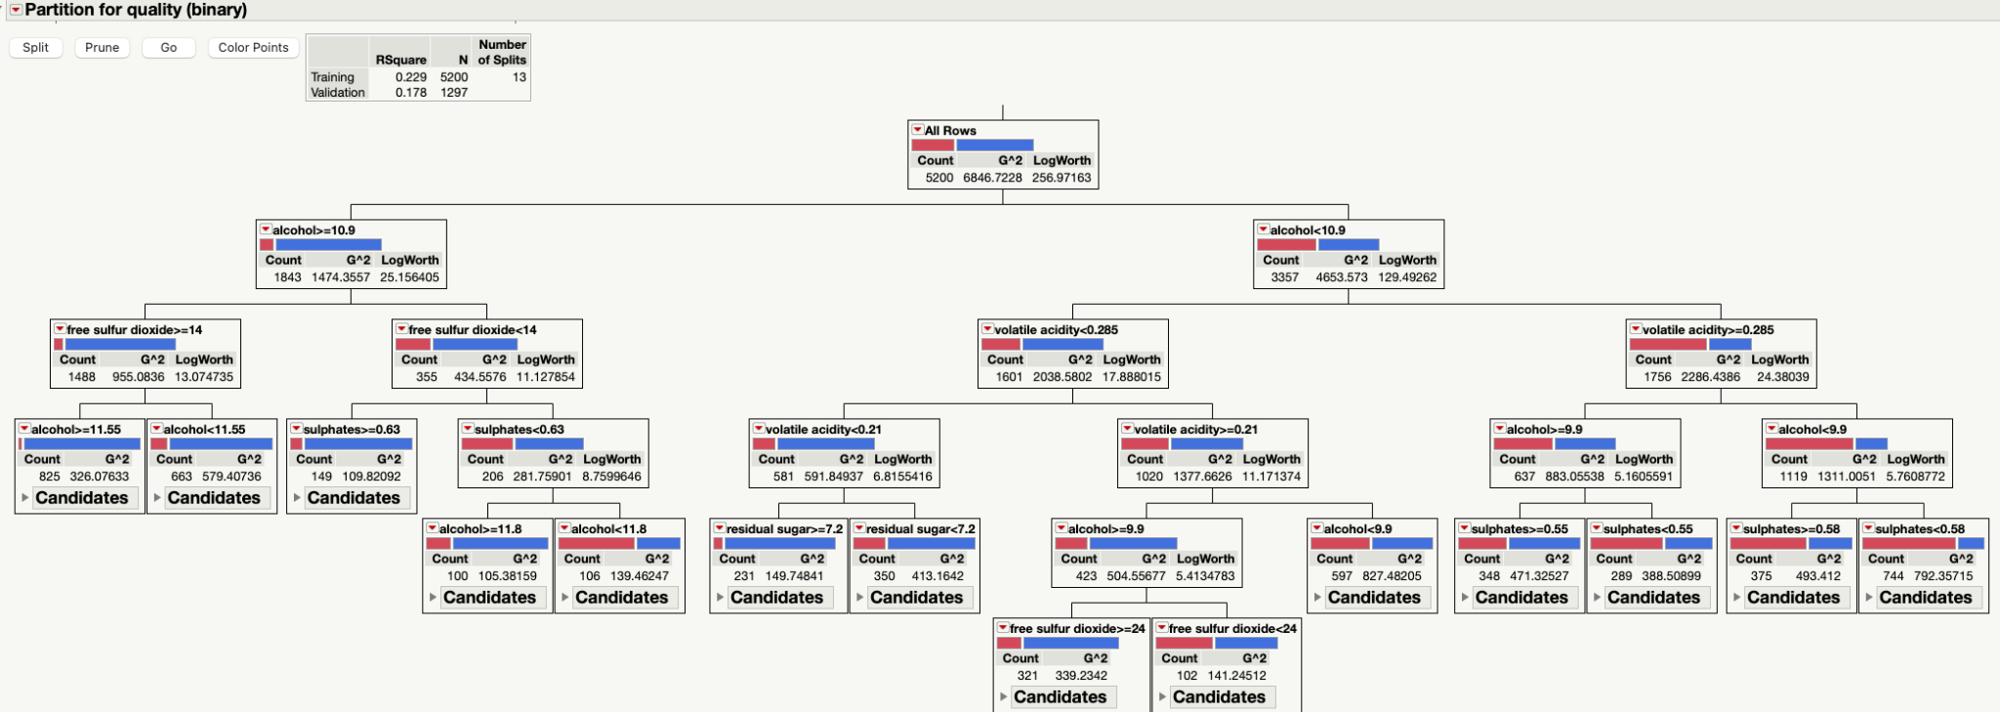
Classification Tree
Results:
Number of Splits:13
Number of Leaves: 14
First Split Variable & Value: Alcohol & 9.9
Training R^2: 0.229
Area Under Curve: 0.8092

Slide 8
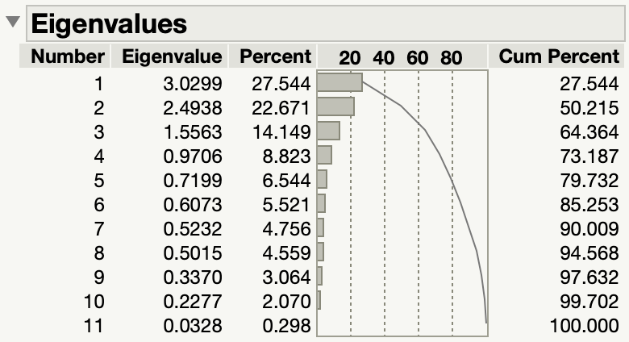
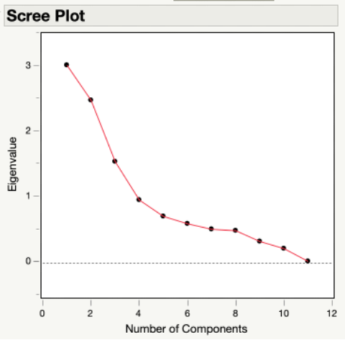
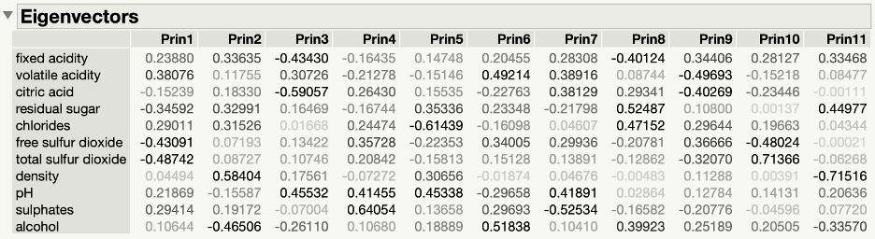
Principal Components Analysis
Analysis:
Eigenvalues ≥ 1 rule
  Components 1 - 3
Cum Percent ≥ 80% rule
  Components 1 - 6
Scree Plot elbow
  Component 6
Eigenvectors variable contribution
Notes:
Principal component analysis (PCA) is a nonparametric statistical technique used to reduce the dimensionality of a dataset by transforming the original variables into a new set of orthogonal variables, called principal components. The main goal of PCA is to identify patterns and structures in high-dimensional data by reducing the number of variables while retaining most of the variability present in the original data. This can help to simplify data analysis, visualization, and modeling tasks by removing noise and redundant information.
Three reports used in PCA are Eigenvalues, Eigenvectors and the scree plot
The eigenvalue for each principal component measures the amount of variation in the original dataset that is captured by that component. The larger the eigenvalue, the more important the corresponding principal component is in explaining the overall variation in the data.
the "cumulative percent" refers to the cumulative percentage of the total variance in the data explained by each principal component.
The eigenvectors table in PCA represents the loadings or weights of the original variables on each principal component (PC). The table shows how much of each variable is contributing to each PC and in what direction (positive or negative).
The bolded values on the table

Slide 9
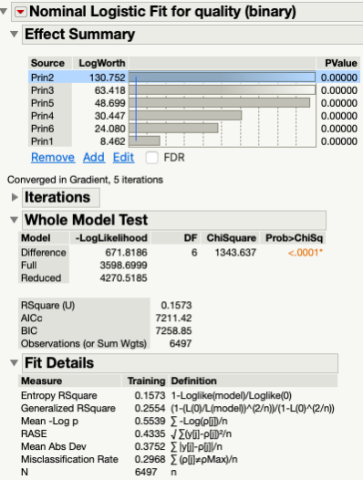
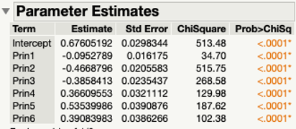
Principal Components Analysis
Results:
6 components
R^2: 0.1573
  6% decrease in accuracy from basic logistical model
RASE: 0.4335
Difficult to Interpret coiffi
Notes:
Since the first 6 PC account for over 85% of variation in the original dataset, we used those 6 PC in our logistic regression.
The model produced an R-square of 0.1573 and a RASE of 4.335. This means that our PCA model explains only about 16% of the variation in the data. About a 6% decrease in accuracy from our basic logistical model.

Slide 10
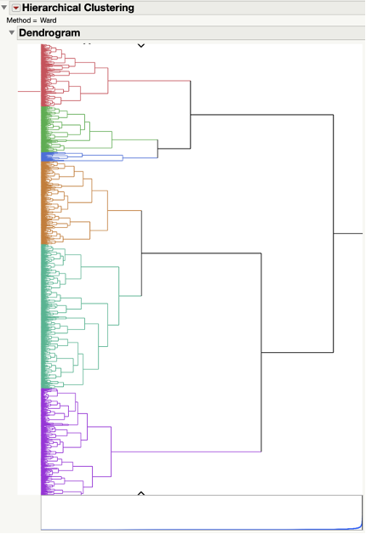
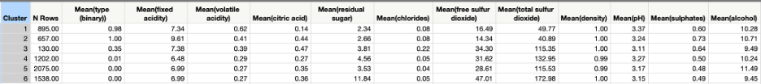
Hierarchical Clustering
Analysis:
Hierarchical Clustering
  Unsupervised machine learning method
Dendrogram
  Tree-like diagram that shows the order in which the clusters are formed
    6 clusters
Table of Means
  Observe the differences in the chemical properties of wine between the different clusters
Notes:
Hierarchical clustering is an unsupervised machine learning method for clustering data objects or observations into groups or clusters based on their similarities or dissimilarities. In hierarchical clustering, the observations are first grouped into individual clusters, and then these clusters are further combined to form larger clusters, forming a hierarchical structure. This hierarchical structure is represented using a dendrogram. depicted in depicted on the right. A dendrogram is a tree-like diagram that shows the order in which the clusters are formed. We decided to use Hierarchical Clustering over other grouping methods, such as K-means clustering, due to its interpretability, the data structure visualization produced by the dendrogram, the ability to mike both continuous and categorical variables and because it does not require the number of clusters to be specified in advance.
For this method we included all variables except our target.
To determine the optimal number of clusters for my model, we examined the elbow of scree plot on the bottom of the dendrogram. We noticed a drastic upswing around cluster 6 and therefore, we assumed that 6 was the optimal number of clusters.
We produced a Table of Means (Table B-1) to help interpret the clusters. By examining the table, we can observe the differences in the chemical properties of wine between the different clusters. For example, cluster 4 has the lowest proportion of red wine (0.01) and the lowest mean pH value (3.27), while cluster 2 has the highest mean fixed acidity (9.61) and mean alcohol content (10.71). These differences in chemical properties can be used to characterize and differentiate the different clusters of wine.
We included these 6 clusters a nominal variable in our logistic regression.

Slide 11
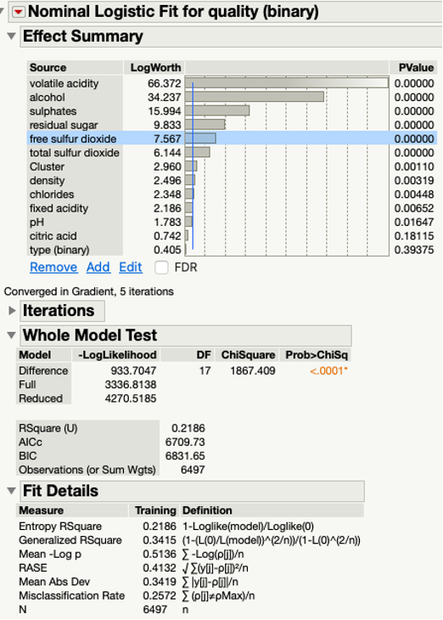
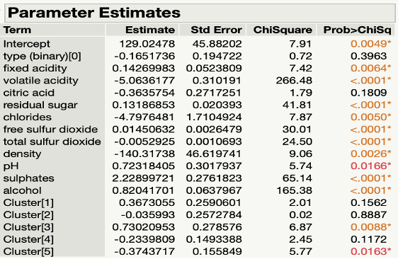
Hierarchical Clustering
Results:
R^2: 0.2186
  0.23% increase in model accuracy from logistic regression
RMSE: 0.4132
Notes:
The addition of the clusters to the regression produced a R^2 of 0.2186 and an RMSE or 0.4132. A 0.23% increase in accuracy over the basic logistic regression. However, the R-square value naturally increases as variables are added so it is possible that the clusters aren’t making a substantial contribution to the model’s predictive power. We also see that with this model, variables such as type and citric acid loose significance.

Slide 12
Conclusion and Recommendations:
Logistic Regression:
Principal Component Analysis:
Future analysis recommendations:
Classification tree
Hierarchical Clustering:
R^2: 0.2163
RASE: 0.4142
R^2: 0.1573
RMSE: 0.4335
Consider creating models with interaction variables
Consider removing outliers from predictor variables.
R^2: 0.229
Area Under Curve: 0.8092
R^2: 0.2186
RMSE: 0.4132

