Slide 1
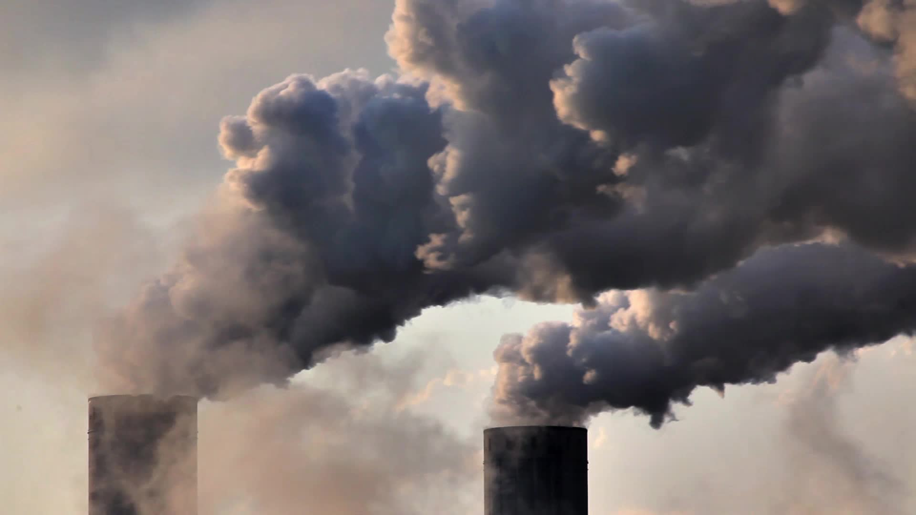
Predict CO2 Emissions
Group 3
Karla Valcarcel Marinez
Stefanie Brown
Swati Mahajan

Slide 2
Business Problem
According to the World Health Organization (WHO), outdoor air pollution has led to approximately 4.2 million premature deaths (“Ambient (Outdoor) Air Pollution”). Additionally, air pollution has led to ocean acidification, which causes ocean temperatures to rise and creates irreversible damages to marine ecosystems. Finally, air pollution leads to food insecurity due to changes in temperature and precipitation affecting crop yields (Ziska et al.) and shifting agricultural zones.

Slide 3
Business Objectives
The primary objective for this project is to discover and understand how CO2 emissions from a vehicle can vary based on different characteristics of that vehicle such as its model, transmission, fuel type and fuel consumption. By understanding what factors increase CO2 emissions, car manufacturers can improve their impact on global warming by reducing the carbon footprint for the vehicles they produce.

Slide 4
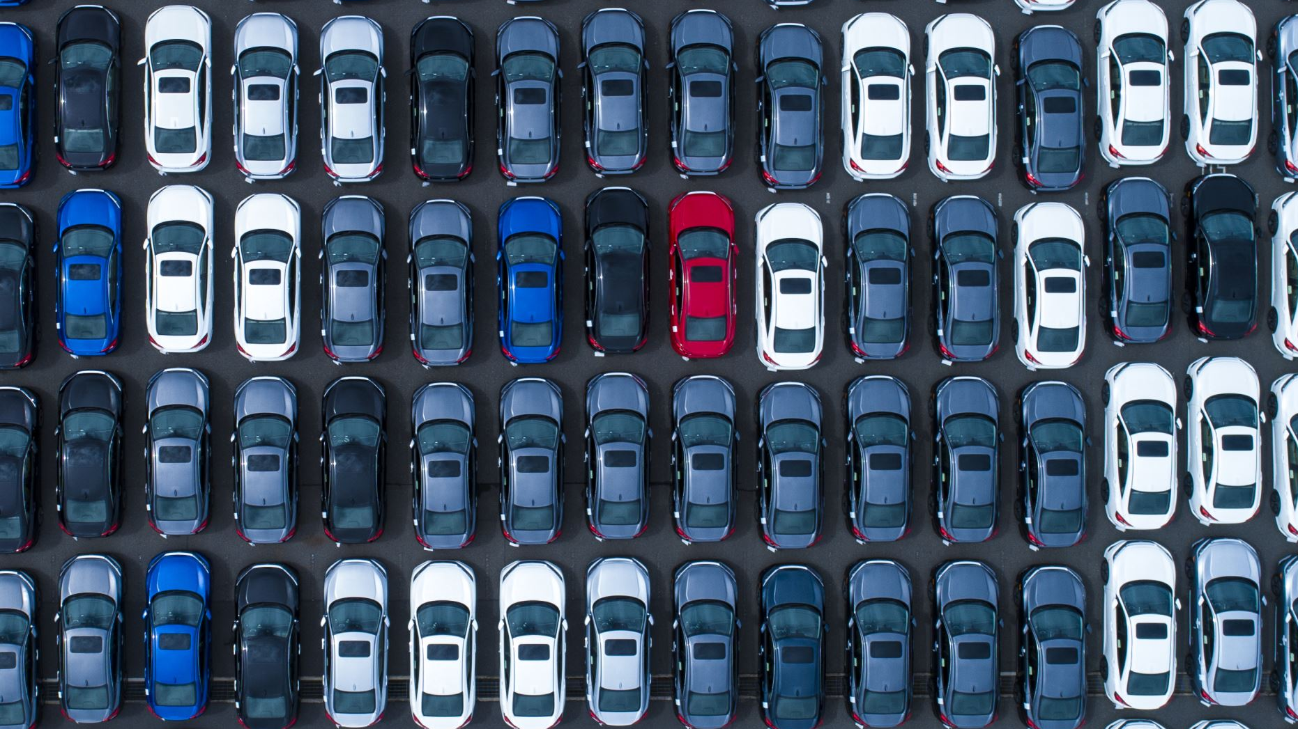
Addressing Business Objectives
What is the influence of different variables in a vehicle on its CO2 emission levels?
What is the most influencing factor on CO2 emissions?
In terms of data analysis, is there a significant difference in the CO2 emissions for fuel consumption by vehicles driven in a city and fuel consumption by vehicles driven on a highway?

Slide 5
Data
We collected the data from Kaggle website. There were 7,385 observations in the dataset. There were no missing values in the dataset.
Target – Continuous variable CO2Emissions
Independent variables – Make, model, Vehicle Class, Engine Size, Cylinders, Transmission, Fuel Type and four Fuel Consumption variables for city, highway, combined in liters and combined in mpg.
We split the dataset into 75% training dataset and 25% validation dataset.

Slide 6
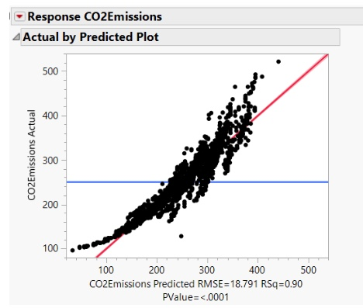
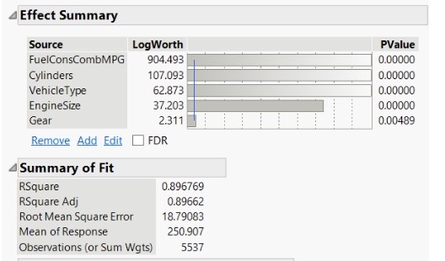
Linear Regression Model

Slide 7
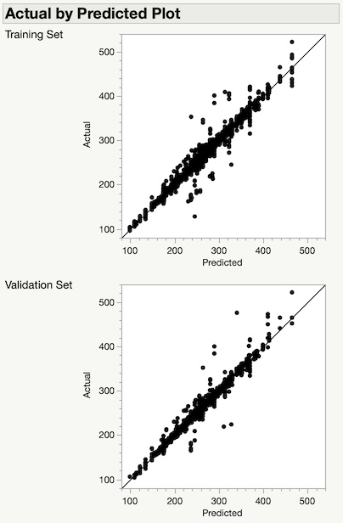

Decision Tree Model

Slide 8
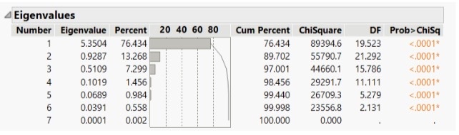
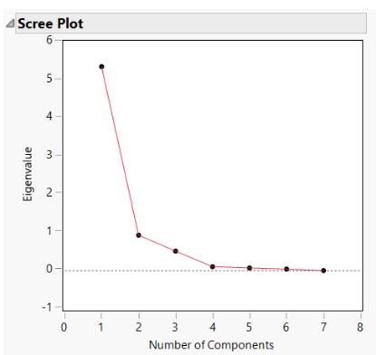
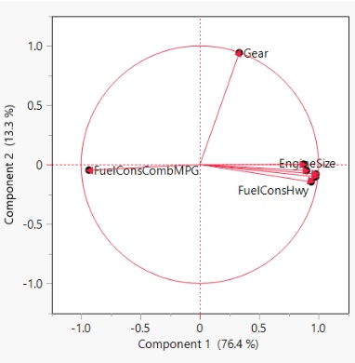
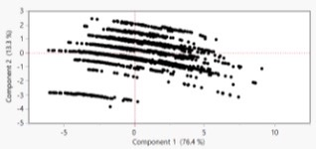
Principal Component Analysis (PCA)

Slide 9
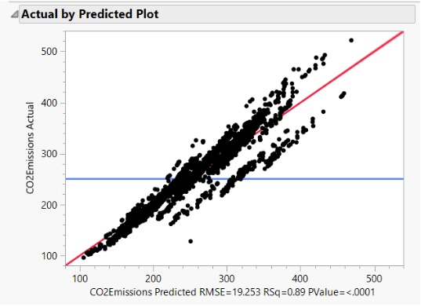
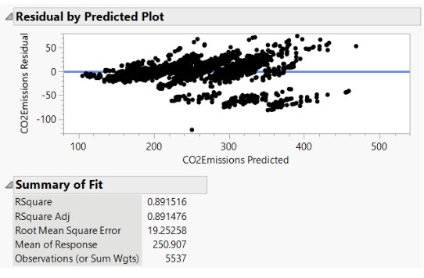
Linear Regression using PCA
The model statistics are shown here.

Slide 10
Model Comparison
Linear Regression - Very easy to implement. Provided high R2 of 0.89 and RMSE of 18.79. CO2 can be easily estimated by plugging the variables into the equation generated:
314 – 6.4Compact + 21Large – 9Medium – 0.6Small + 7.1EngineSize + 8.7Cylinder – 0.5Gear – 4.6FuelMPG
Decision Tree - Easy to implement using JMP software. It resulted in139 splits for our dataset, which made it difficult to interpret and capture. It provided the best R2 of 0.978 on training and 0.969 on validation and provided the least RASE of 8.7 for training dataset and 10.2 for validation dataset.
Principal Component - Easy to implement using JMP software. Reduced the input variables to only two principal Components, though it is difficult to find any direct relationship between the actual variables and Principal Components. Provided R2 of 0.89 And RMSE of 19.29

Slide 11

Results
Both Linear Regression models provide similar R2 of 0.89 and RMSE of about 19. However, the Decision Tree model provides better results in terms of R2 of 0.97 and RASE between 8 to 10. It is difficult to interpret the large decision tree with 139 splits and draw any direct conclusion.
For a dataset like ours, we would prefer a Linear Regression model which is easy to interpret, and we can draw important conclusions and recommendations based on the model equation:
CO2Emission = 314 – 6.4Compact + 21Large – 9Medium – 0.6Small + 7.1EngineSize + 8.7Cylinder – 0.5Gear – 4.6FuelMPG
Our analysis helped us find that smaller vehicles and vehicles with smaller transmission tended to release less Co2 into the environment

Slide 12
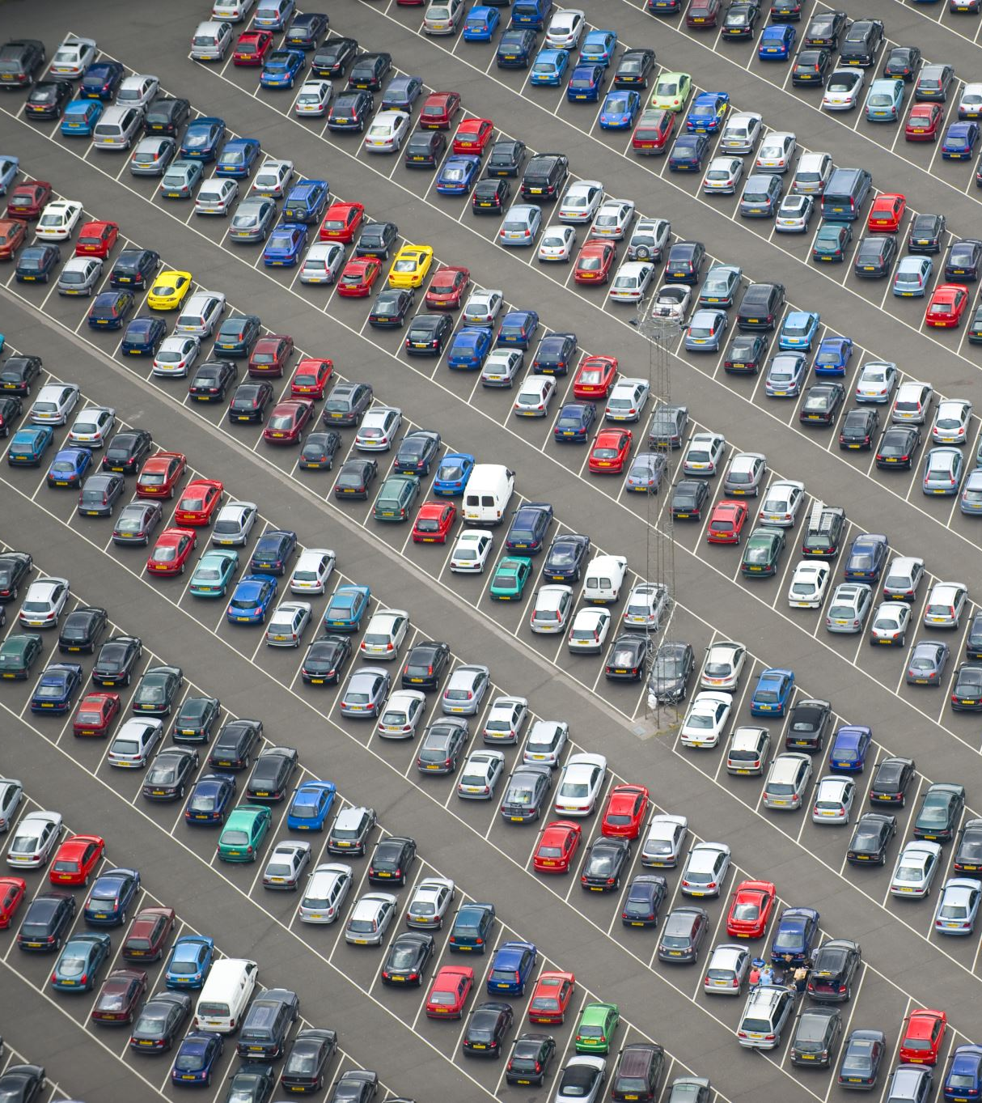
Recommendations
Large cars like cargo vans, large passenger cars and trucks have highest CO2 emissions. Users should prefer compact, small and medium size cars/SUVs.
Engine size and number of cylinders in a car have an impact on the CO2 emissions as well. To lower the CO2 emissions, one should prefer a car with smaller engine size and lower number of cylinders.
Cars with high miles per gallon (MPG) should be preferred over the ones provides lower mpg to reduce the CO2 emissions

