Slide 1
Predicting NFL Matchups
Prepared By: Adam Kubiak and Jim Monk
Group 2

Slide 2

Business problem description
The motivations behind this analysis overlap with the interest of gambling venues in terms of predicting the winners of these games, however, the results of this analysis differ.
Project Objectives
Explore how weather conditions, home/away, or if gambling spreads influence a NFL football game.
Develop a model to predict a winner of an NFL game.

Slide 3
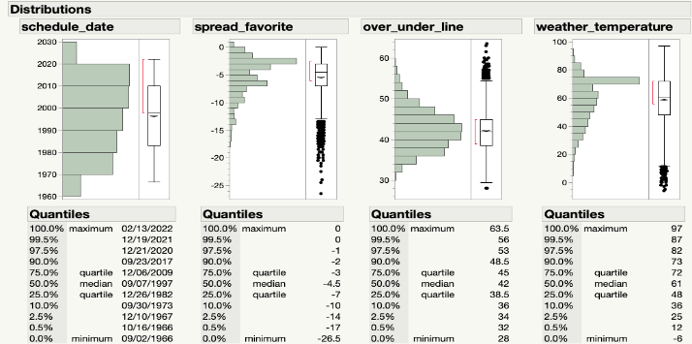
Data overview
The primary dataset used for this analysis comes from Kaggle.com contributor spreadspoke and contains pre-game data related to NFL football games
  Contains 13,232 observations and 15 variables, five of which are continuous variables.
  A supplemental dataset with additional information on NFL contains an additional 15 variables and 107 observations.
The prepared dataset has 2350 observations and eight variables including the target, six of which are continuous
  The Response Variable is home_team_win, a nominal variable
Attribute Name | Data Type | Description
schedule_date | Nominal | The date on which the game occurred
schedule_season | Numerical, Integer | The year in which the season began
schedule_week | Numerical, Integer | The week of the game within the season
schedule_playoff | Nominal, Boolean | Whether the game was a playoff game
team_home | Nominal | The home team’s name
score_home | Numerical, Integer | The number of points scored by the home team
score_away | Numerical, Integer | The number of points scored by the home team
team_away | Nominal | The away team’s name
team_favorite_id | Nominal | The 3-letter abbreviation for the team favorited to win the game
spread_favorite | Numerical, Real | A value added to a team’s actual score, typically used in gambling⁸
over_under_line | Numerical, Integer | The betting line used for gambling
stadium | Nominal | The stadium at which the game was played
stadium_neutral | Nominal, Boolean | Whether the stadium was a neutral location, i.e. neither home nor away
weather_temperature | Numerical | The temperature at game time in F
weather_wind_mph | Numerical | The wind speed at game time in mph
weather_humidity | Numerical | The humidity at game time
weather_detail | Nominal | A description of game time weather
ELEVATION | Nominal | The elevation of the stadium
home_team_win | Nominal, Boolean | Whether the home team won the game
Descriptive Analytics

Slide 4
Modeling techniques
Model 1: Logistic Regression Model
  Generalized R2 value and target value is Binary.
Model 2: Decision Tree Model
  Classification Tree since target variable is categorical.
  Great fit due to the fact we are determining a winner of a game.
Model 3: Neural Network Model
  Efficiently models different types of relationships between variables.
  Offers better predictive performance at the expense of transparency.

Slide 5
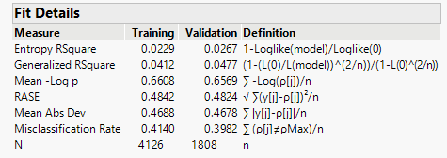
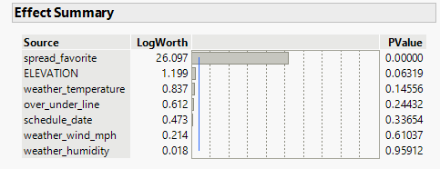
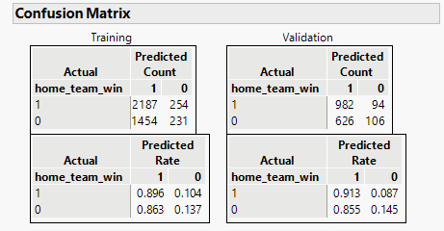
Logistic regression
Final Model
Created with seven independent variables
Spread_Favorite by far had the biggest effect on winning games
Miscalculation Rate .40
Generalized R2 value of .0477
Accuracy Rate of 60%

Slide 6
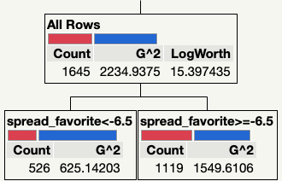
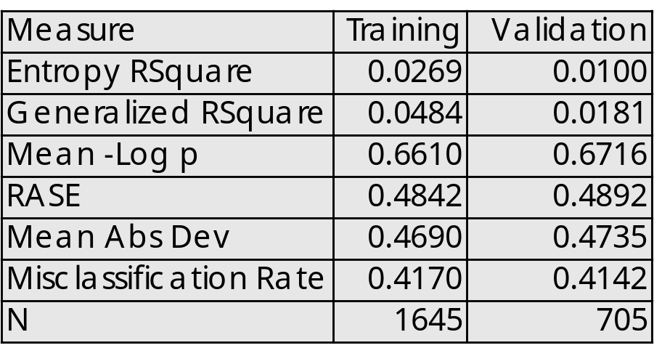
Decision tree
Final Model
One split was created within the decision tree
It was split at Spread_Favorite when <-6.5
Miscalculation Rate .41
Generalized R2 value of .0181
Accuracy Rate of 59%

Slide 7
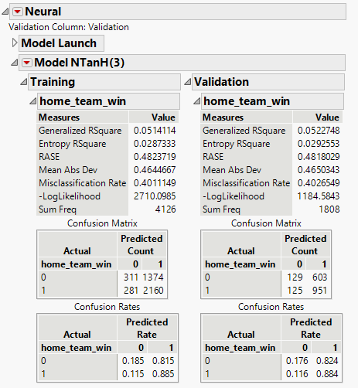
Boosted Neural network
Final Model
This model was created using the 7 independent variables
Boosted Neural Network, Number of Models = 100
Miscalculation Rate .40
Generalized R2 value of .0522
RASE value is .4818

Slide 8
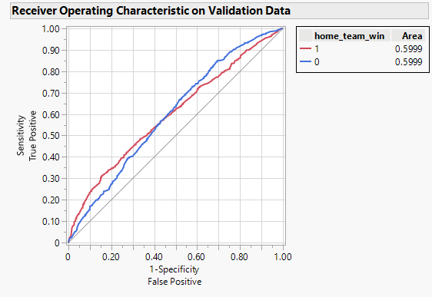
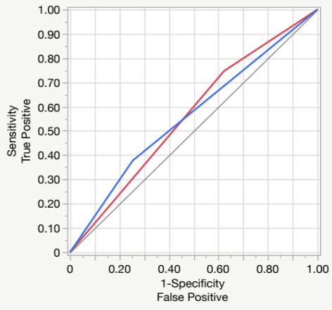
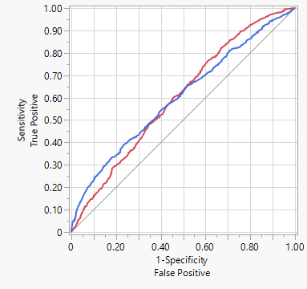
Model comparison
Logistic Regression
Model | R-Squared | Misclassification | RASE
Logistic Regression | .0477 | .3982 | .4824
Decision Tree | .0181 | .4142 | .4892
BNN | .0523 | .4026 | .4818
Decision Tree
The Boosted Neural Network has the highest R-Squared value of 0.0523.
The Boosted Neural Network is the best prediction model with its higher Area Under the Curve value of 0.6021.
BoostedNeural Network

Slide 9
Conclusion
Model predictive performance was bad
Source data needs reevaluation
We still learned something!

