Slide 1
Analysis of Streaming Providers’ Customer Retention
Project Group 7
Aaunuoluwapo Ojelade
Robert Umphlet
Jamie Underwood
Notes:
Hello and welcome to our video! Over the next few minutes, we will be discussing our project and results on the analysis of streaming providers’ customer retention.

Slide 2
Business Problem Description
Paid streaming video services provide entertainment content delivered via an internet connection to subscribers. The streaming industry is subject to volatile subscriber rates and high customer turnover. Competitors must learn to balance content, costs and profits to better retain subscribers.
Objectives:
Use data mining techniques to help increase customer retention. Uncover the factors that are linked to turnover to aid in managerial decision making.
Develop models for predicting turnover/retention.
Notes:
In our project we explored customer retention in the video streaming services industry. This industry includes many well-known companies that provide paid streaming video services that deliver content to customers via the internet. The streaming services industry, like many other commercial industries, is subject to high consumer turnover rates. This is in part due to the large variety of content available across provider platforms and the recent increases in competition, many of whom have taken control of their content that was previously hosted by now competitors. Segmentation of content on top of high consumer churn rates requires providers to balance content with costs to better retain consumers and maintain their bottom-line.
In our project we will be calling upon a variety of data mining techniques to help deliver results providers can use to increase customer retention. We believe that these companies would benefit substantially by identifying factors that are linked to consumer turnover and our project focuses on models to identify those factors. We believe that we have developed a model that will aid management in predicting consumer turnover and retention.

Slide 3
Data Overview
Source
Data Dictionary - Selected
Attribute Name | Data Type | Attribute Description
CHURN | Categorical – Nominal Dependent | A dummy variable for customer churn. 1 if customer churns (no longer a customer) and 0 if customer does not churn (remains a customer).
ACCOUNT LENGTH | Continuous | The age of a customer’s account in months
AREA CODE | Categorical – Nominal | The area code of customers
DAY MINUTES | Continuous | The total number of minutes a customer used during the daytime in a plan period
DAY CALLS | Continuous | The total number of calls a customer made during the daytime in a plan period
DAY CHARGE | Continuous | The amount a customer was charged for the minutes used during the daytime in a plan period
EVE MINUTES | Continuous | The total number of minutes a customer used during the evening in a plan period
EVE CALLS | Continuous | The total number of calls a customer made during the evening in a plan period
EVE CHARGE | Continuous | The amount a customer was charged for the minutes used during the evening in a plan period
NIGHT MINUTES | Continuous | The total number of minutes a customer used during the night in a single period
NIGHT CALLS | Continuous | The total number of calls a customer made during the night in a plan period
NIGHT CHARGE | Continuous | The amount a customer was charged for the minutes used during the night in a plan period
SERVICE CALLS | Continuous | The number of customer service calls a customer has made in a plan period
Telecommunications Churn Data retrieved from Data World (Wakefield, 2019)
Why Telecommunications?
Limited public data-sets for customers of streaming services. Use telecommunications as a substitute due to similarities between industries
Characteristics
Target: Binary Churn
Observations: 12,892
Initial Attributes: 22
Selected Attributes: 13
Notes:
In seeking out data sources we found that unfortunately, public data on consumer churn in the video streaming services industry is very limited. Streaming companies only provide overall numbers of subscribers and do not make their data on consumer churn and corresponding customer data publicly available. We therefore turned to a consumer churn data set from the telecommunications industry. We believe that the two industries have parallels to one another and that results from telecom data can be applied to the video streaming services industry. These industries are both technology sector industries that are focused on the service of delivering content to their subscribers. Those subscribers would often have similar motivations for churn based on content, cost, quality of service, and other factors.
The data set we used for analysis is sourced from the data.world website. The data-set, that was posted in 2019, was downloaded with an initial 22 attributes, 15 of which were continuous. We identified our target attribute as the binary variable CHURN where ‘1’ represents customer churn and ‘0’ represents customer retention. We decided against using certain attributes from the original data set including the fields: unique identifiers, international plan, and voicemail attributes; which we determined to be irrelevant to our analysis. We ultimately ended up with 13 attributes; the binary target CHURN and then 1 categorical and 11 continuous explanatory variables. A data dictionary of the attributes used in analysis is provided on this slide.

Slide 4
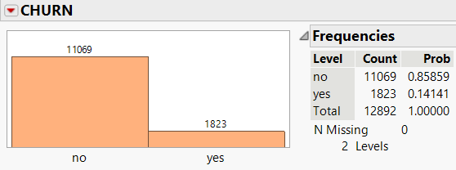
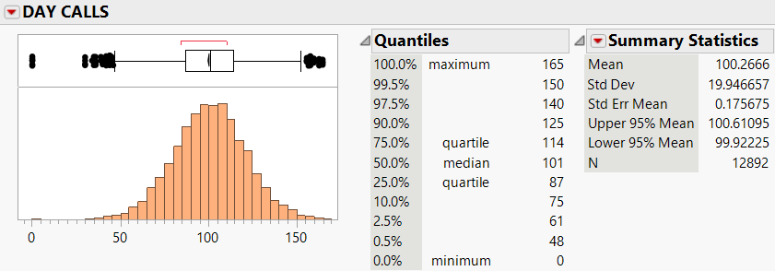
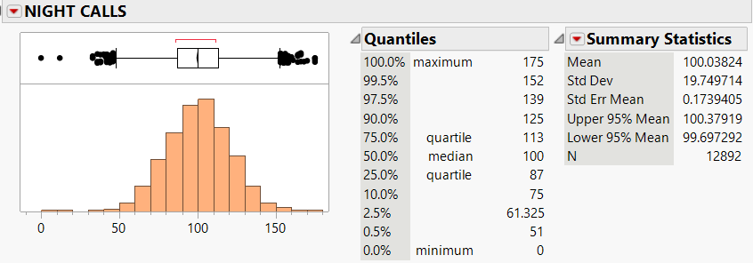
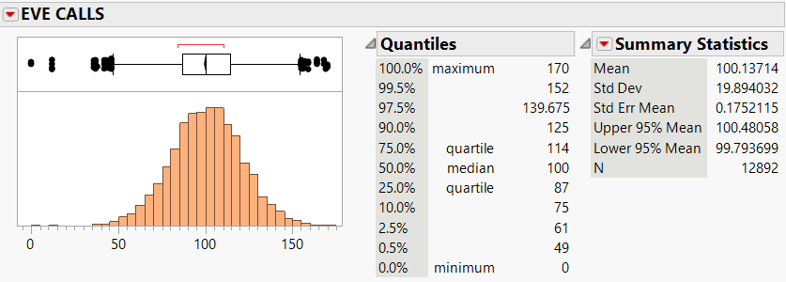
Descriptive Analytics
Target Churn
Explanatory Variables Key Takeaways
The count of calls made did not significantly vary based on the time-of-day calls were made
Max range: 165 – 175
Median of 100 – 101
Unbalanced target observations
Solution: data preparation step to oversample the data-set prior to further analysis
Observations after oversampling:
Training set – 16,604
Validation set – 5,534
Attribute | Mean | Max | Median
DAY MINUTES | 180.16 | 351.5 | 180.0
EVE MINUTES | 200.72 | 363.7 | 201.2
NIGHT MINUTES | 200.56 | 395.0 | 200.8
Attribute minutes observed greater variation depending on time-of-day
Notes:
Our first step in analysis was to perform descriptive analytics. This step was vital in gaining an understanding of the data-set prior to predictive modeling. One very important finding was that our data-set had a very unbalanced proportion of the target churn. The original data-set had approximately 86% of retention outcomes and only 14% of customers churning. To address this issue, we used an oversampling technique to get a more balanced target outcome. Following oversampling the data we then separated the data into training and validation sets with 16,604 observations in the training set and 5,534 in the validation.
Analysis of continuous attribute distributions revealed that customers do not have a major difference in the number of calls made depending on the time of day. The length of calls sees a little more variation depending on the time of day with an average of 180 minutes during the day and 200 minutes in the evening and at night. We found no other significant findings in our process of descriptive analytics.

Slide 5
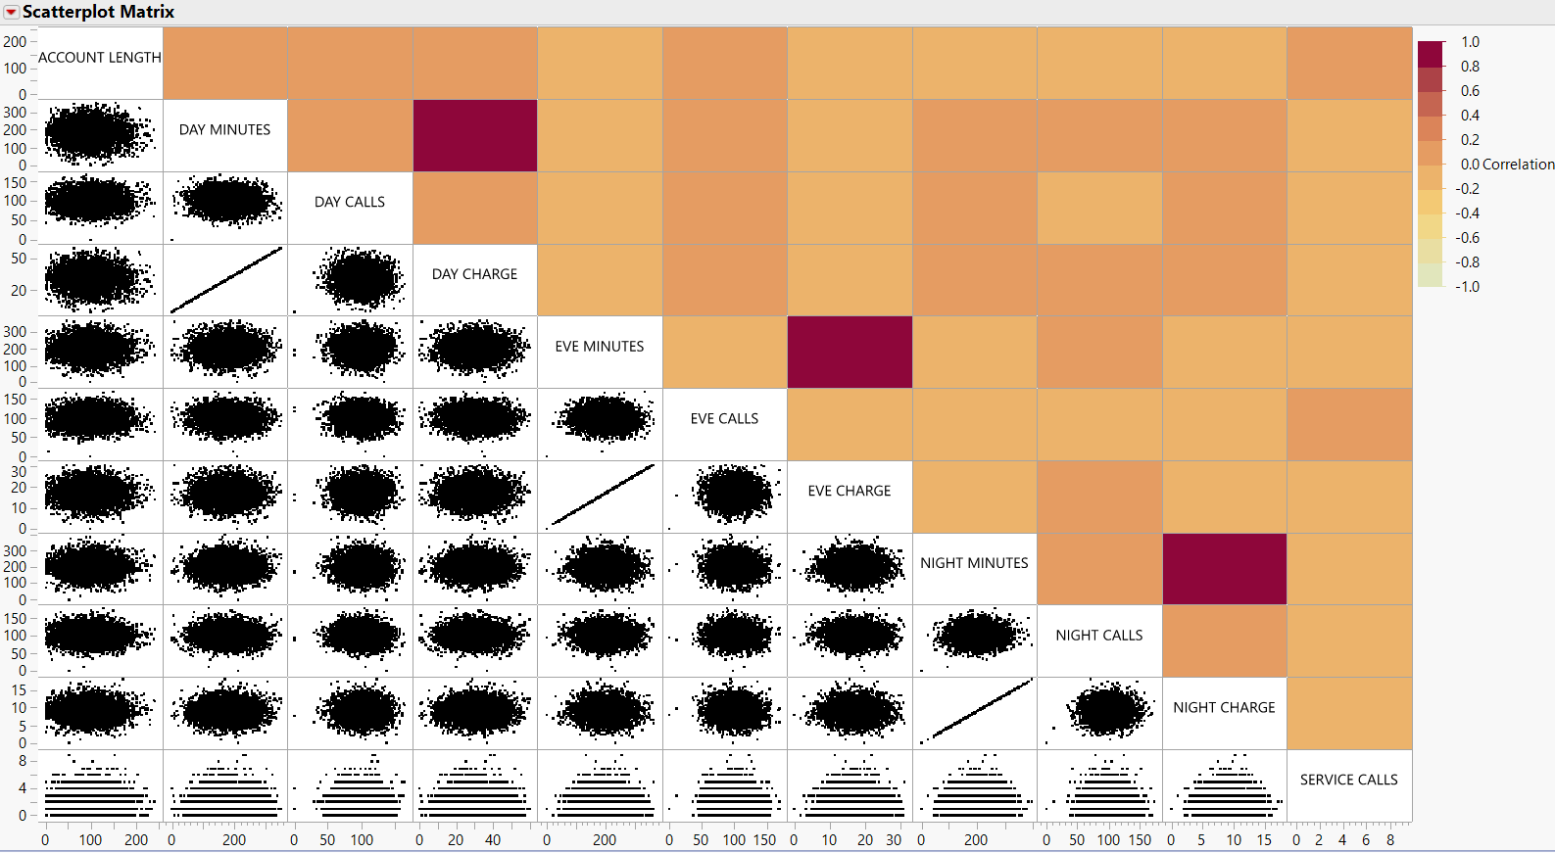
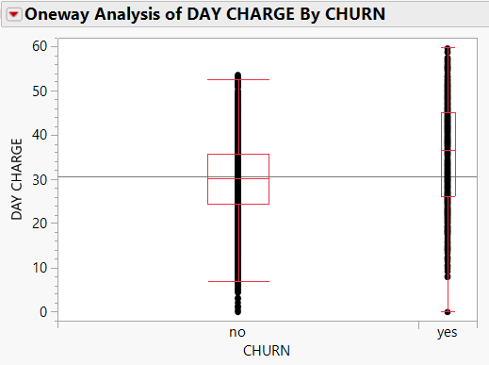
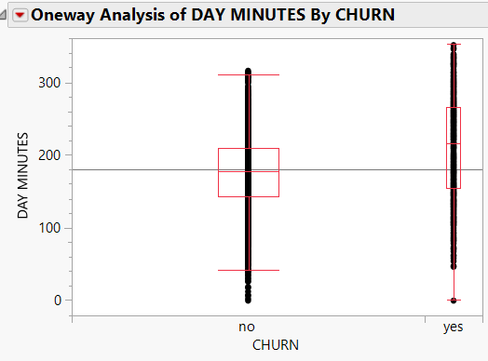
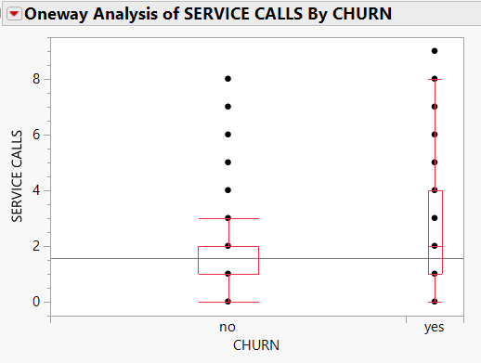
Multicollinearity analysis
There appears to be direct relationship between call minutes and call charge
Box Plots show DAY CHARGE, DAY MINUTES, and SERVICE CALLS with greatest difference between means for churn levels
Notes:
Following our initial step of performing descriptive analytics we then performed multicollinearity analysis on the continuous attributes as shown by the scatterplot matrix. What we found is that there is a direct relationship between call minute and charge variables which have correlation values of 1.000. This relationship suggests that customers pay a fixed rate per minute of call use. This is important to keep in mind when performing predictive analytics as call and minute attributes may have similar contributions to models when explaining variation in customer CHURN, but minute attributes may have greater influence due to the greater values from the unit measure of minutes versus the amount of charges.
In addition to our multicollinearity analysis performed on explanatory variables, we also performed correlation analysis on explanatory variables against our target CHRUN. Few insights were gained from this analysis, however we did identify the attributes of DAY CHARGE, DAY MINUTES and SERVICE CALLS as having the greatest difference in mean values depending on whether customers churned as shown in the box-plots on the slide. This would suggest that these three attributes have the strongest relationship with CHURN of the attributes we analyzed.

Slide 6
Modeling Techniques
Model 1: Logistic Regression
A logistic model was used to predict the binary target churn.
Model 2: PCA and Regression with Components
PCA analysis was chosen to analyze the data using a method that can help reduce issues with multicollinearity between explanatory variabables.
Model 3: Neural Network
Neural network models typically have strong predictive abilities and can introduce non-linear functions to churn prediction
Notes:
After completing our initial exploratory analysis we then choose three modeling techniques to apply to our oversampled data-set. We choose the three models of logistic regression, principal component analysis, and neural network. We choose the logistic model to serve as a baseline predictive model for our binary target CHURN with the hopes that step-wise functions would help identify variables of importance prior to our other modeling techniques chosen. Principal component analysis was chosen as this technique can address potential issues with multicollinearity between the explanatory attributes. Use of PCA analysis can create uncorrelated components that can then be used in logistic regression to predict customer CHURN. The final model of neural network was chosen as typically these models have high performance in predicting outcomes accurately and can map nonlinear relationships that the other two models do not.

Slide 7
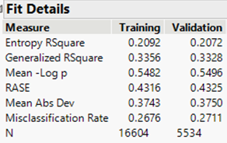
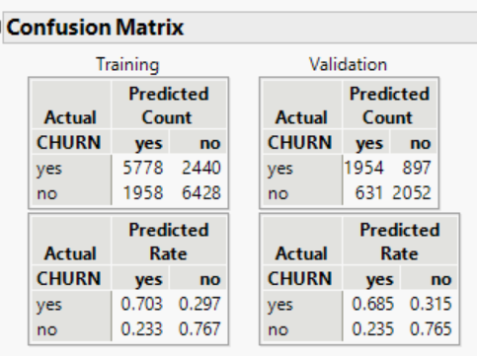
Model 1: Logistic Regression
Regression Results
Attributes used in the model:
ACCOUNT LENGTH
AREA CODE
DAY MINUTES
EVE MINUTES
NIGHT CHARGE
SERVICE CALLS
Notes:
The first predictive model considered was a logistic regression model. The first step was to perform a stepwise regression to identify the attributes most important when explaining variation in the data-set. The attributes of ACCOUNT LENGTH, AREA CODE, DAY MINUTES, EVE MINUTES, NIGHT CHARGE, and SERVICE CALLS were identified as important and were used in the subsequent logistic regression model which has its fit details displayed on this slide. The model was found to be overall significant, though the model does have poor performance measures such as a weak relationship between explanatory variables and the target CHURN indicated by the generalized Rsquare less than 0.5. Similar fit statistics between the training and validation sets indicates the model does not overfit the data, a good sign that the model can be applied to new observations to perform classification.

Slide 8
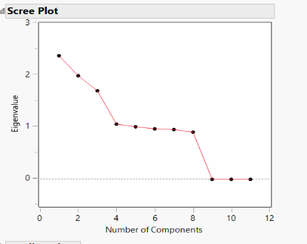
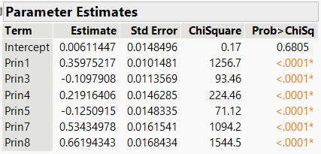
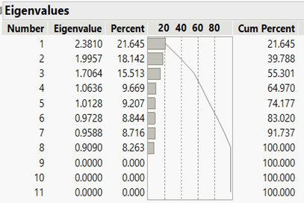
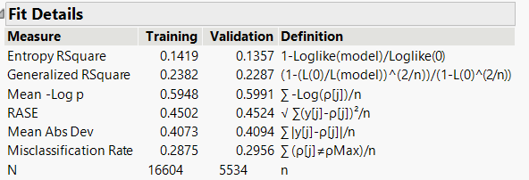
Model 2: Principal Components
Interdependence Results
PCA Regression Model OMIT PC2 and 6
Notes:
The next model considered is a principal components model. This required the independence technique of principal component analysis to be performed prior to developing a predictive logistic model. Results from the principal component analysis are provided on the left-hand side of the slide and show that the first 8 components had significant contributions to explaining variation in the data-set. This is indicated by component contributions greater than 1 for the first 5 components and greater than 0.9 for the next 3 components as shown in the eigenvalue analysis table. The scree plot supports these findings by showing a bend in the line at 8 principal components.
The first 8 components from principal component analysis were used in a logistic regression model. The results of the initial model showed that principal components 2 and 6 had coefficients not significantly different from zero, meaning the two components were insignificant when explaining variation in the variable CHURN. The model was then re-performed excluding those two principal components with the results displayed on this slide. The resulting model is overall significant with all components used having coefficients significantly different from zero. However, the generalized RSquare is again lower than 0.5 indicating a weak relationship between the explanatory component variables and the target CHURN.

Slide 9
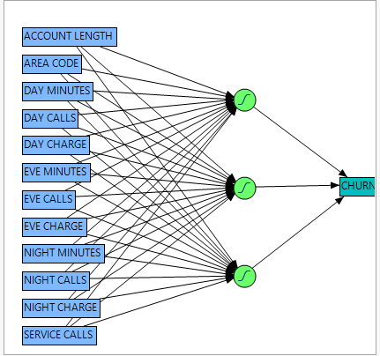
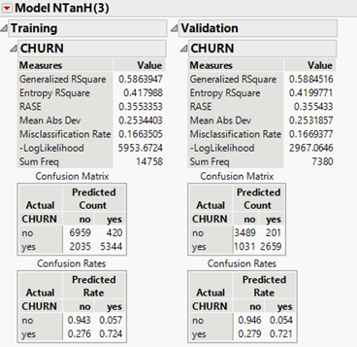
Model 3: Neural Network
Model Diagram
Performance Results
Notes:
The final Model considered is a neural network model. The results of this model are displayed on the slide. The model was created using a 0.33 hold back validation and 10 tours selected as the fitting options. The neural network model results are more difficult to display compared to the logistic regression and principal component models, however the hidden node use of non-linear functions allows for more complex mapping of relationships between the explanatory variables and CHURN. This means that while the model may be difficult to visually interpret, statistical measures such as the generalized Rsquare and root average square error outperform the other two models, as is discussed on the next slide.

Slide 10
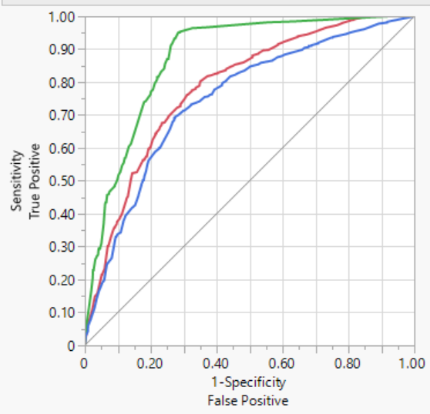
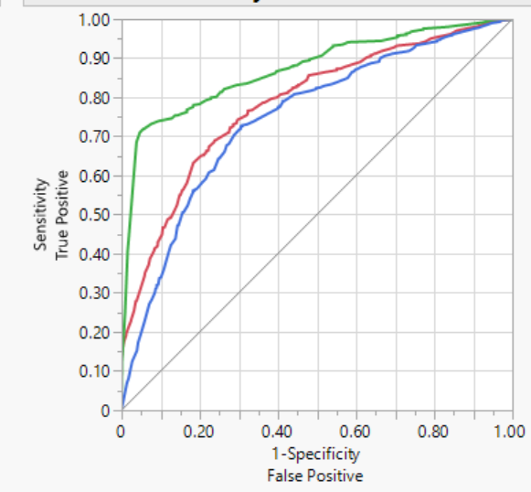
MODEL Comparisons
 | Accuracy |  | Specificity |  | Sensitivity |  | AUC
 | Training | Validation | Training | Validation | Training | Validation | Training | Validation
Logistic Regression | 0.735 | 0.724 | 0.703 | 0.685 | 0.767 | 0.765 | 0.792 | 0.784
PCA | 0.712 | 0.704 | 0.707 | 0.705 | 0.718 | 0.704 | 0.753 | 0.748
Neural Network | 0.834 | 0.833 | 0.724 | 0.721 | 0.943 | 0.946 | 0.872 | 0.873
 | Creator​ | RSquare​ | RASE​ | Misclassification Rate​ | AUC​
 | Stepwise Logistic Regression​ | 0.3392 | 0.4306 | 0.2649 | 0.7919
 | Neural Model​ | 0.5886 | 0.3544 | 0.1649 | 0.8723
 | PCA Logistic Regression​ | 0.2389 | 0.4500 | 0.2896 | 0.7535
TRAINING
CHURN = no
CHURN = yes
Stepwise Logistic
Neural Network
 | Creator​ | RSquare​ | RASE​ | Misclassification Rate​ | AUC​
 | Stepwise Logistic Regression​ | 0.3220 | 0.4352 | 0.2761 | 0.7843
 | Neural Model​ | 0.5818 | 0.3583 | 0.1715 | 0.8731
 | PCA Logistic Regression​ | 0.2255 | 0.4529 | 0.2942 | 0.7476
PCA Logistic
VALIDATION
Notes:
This slide provides a summary table for the performance measures considered when comparing the models. For each model both training and validation set results are shown except for the ROC curves which only display curves for the validation data sets. The generalized Rsquare provides an indication for the strength of relationships between explanatory variables and the target CHURN where higher values indicate better performance. Root Average Square Error, or RASE, displays an accuracy measure based on the difference between predicted and actual Churn outcomes where it is better to have a lower. For both measures the Neural network model outperforms the other two. For the misclassification rate it is again better to have a lower number and again the neural network model is the best performing model.
For the measures of accuracy, specificity, and sensitivity; those measures were calculated based on values from confusion matrices where retention was considered a positive outcome and churn negative. For each measure it is more desirable to have a higher value and in each instance the neural network model outperforms the other two, meaning the model has more instances in which positive and negative outcomes are correctly classified. These measures are visually displayed in the ROC curves which plot true positive rates against false positive rates for the classification of CHURN. For these curves it is better to have a large area under the curve with better performing models having curves higher above the diagonal random classification line. We again find evidence that the neural network model is the best performing model based on the validation ROC curves for the three models.

Slide 11
Conclusion
Neural Network Model is the best performing model
Time spent consuming content is an important indicator of retention
Account length, cost, and customer service attributes are also important when considering customer churn
Notes:
From our analysis we found that the neural network model was the best performing of the three models applied against consumer churn data. We would recommend that streaming service providers use neural network models when predicting consumer churn and retention. However, this model cannot be considered in isolation. Application of the neural network model is enhanced when used in conjunction with other models such as the logistic regression model. The logistic regression model helped to identify attributes that are important when predicating customer churn. This includes the findings in the data analyzed in this study that time consumers spend consuming content is very important when predicting churn, even more so than the number of times a consumer accesses their account. Additionally, logistic regression identified attributes related to account length, cost, and customer service as being important when predicting consumer churn. This means these are important factors streaming service providers need to also consider when working to improve customer retention.
We do; however, understand that our analytical results may be limited in their ability to generalize to the streaming service industry due to the use of a telecom data set. We therefore call for future analysis to be performed using a data-set sourced from a video streaming service provider and recommend that a similar process of analyses be used to analyze data.

Slide 12
THANK YOU
Notes:
Thank you for your time and this concludes the BIT5534 Spring 2022 Group 7 presentation.

